Slide 1
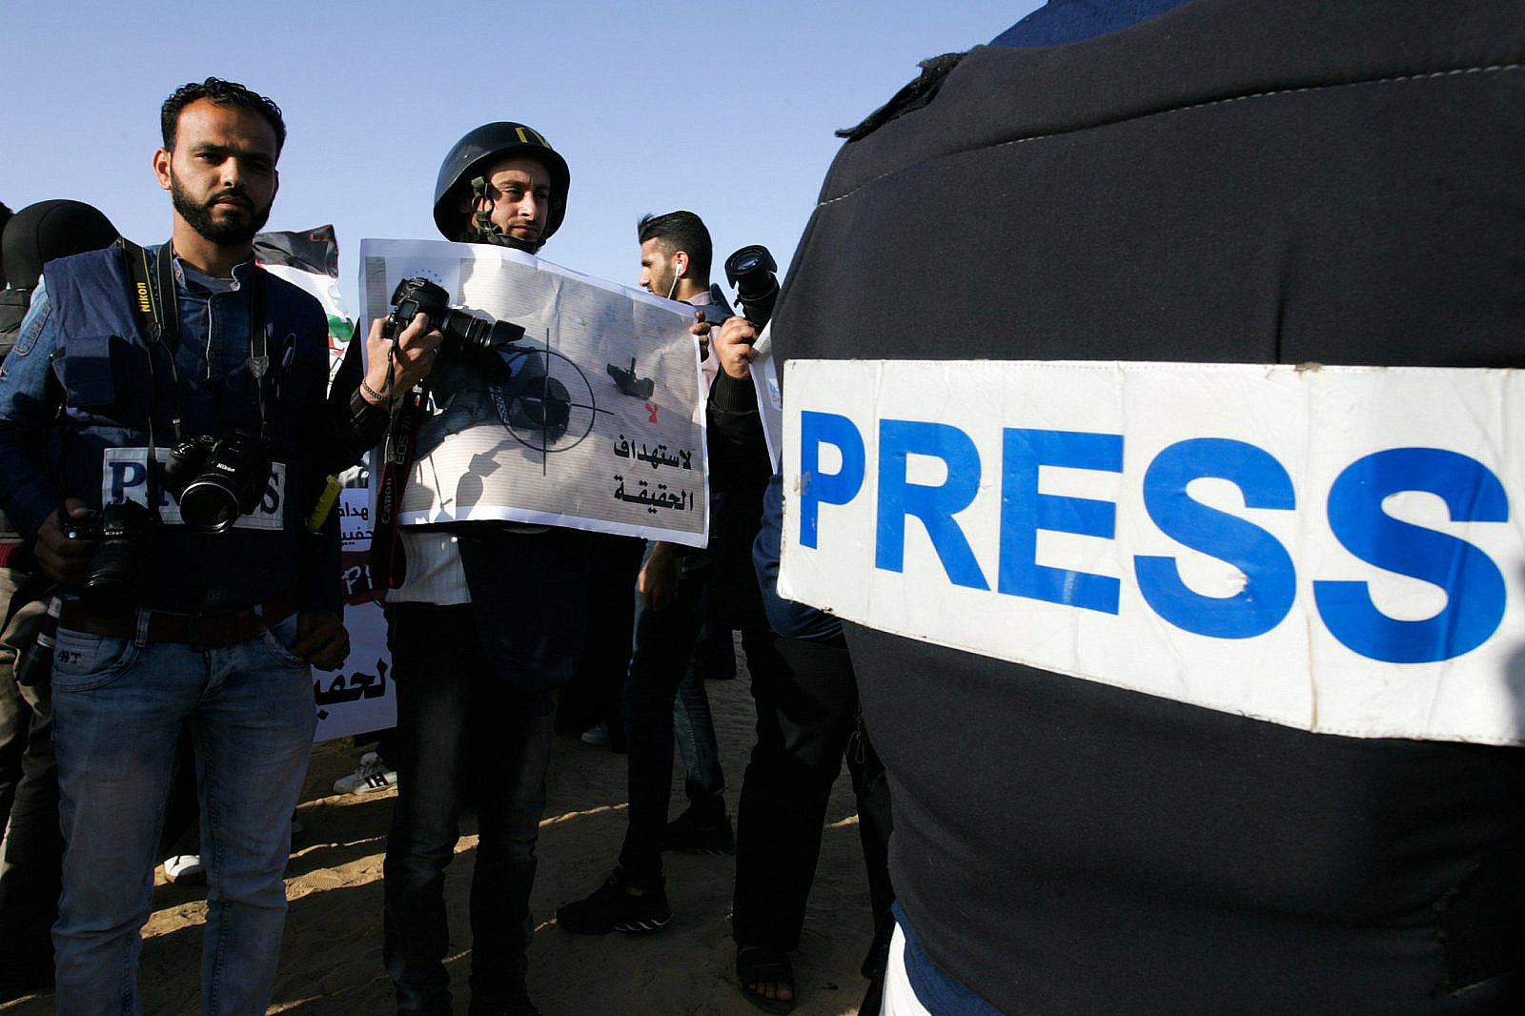
Israel & Palestine
Exploring Differences in News Coverage of the 2023 Israel-Hamas War
Max Eckert
Kai Foerster
Steven Kerr
Danial Riaz
Sources: Abed Rahim Khatib/ Flash90 via +972 Magazine
Notes:
ME

Slide 2
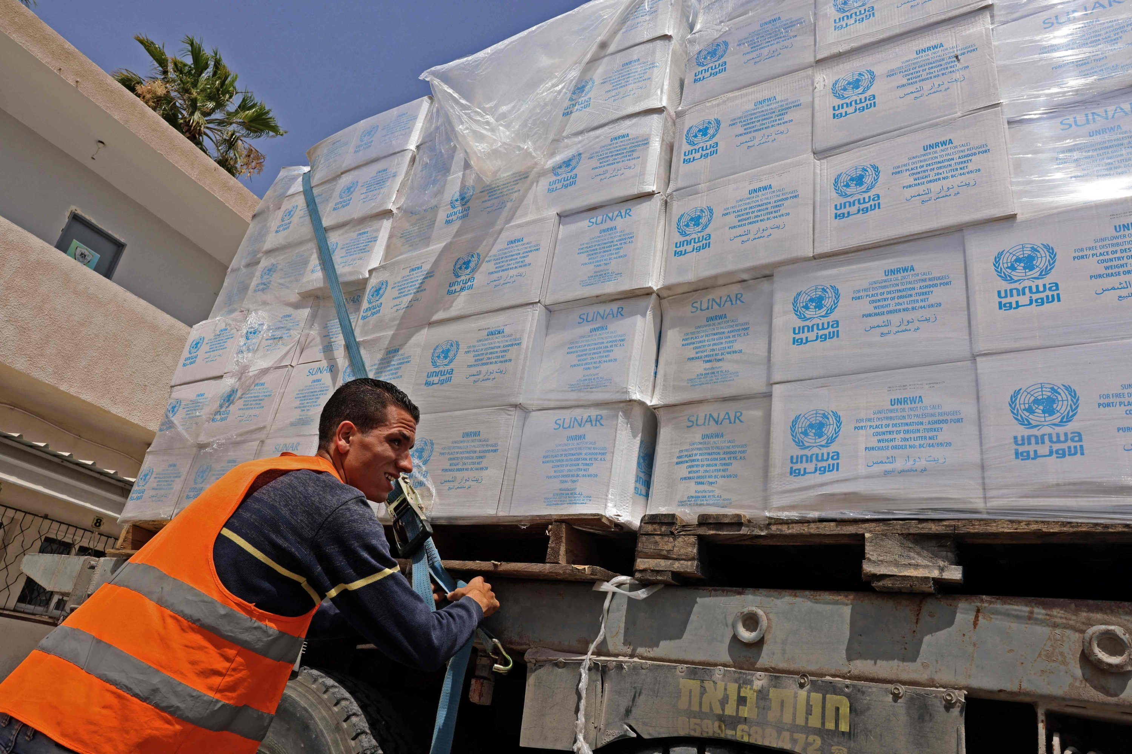
Outline
Background & Research Question
Data Collection
Descriptive Analysis
Dimensionality Reduction
Topic Modelling
Sentiment Analysis
Discussion & Limitations
Future Work
Source: Getty Images via Middle East Eye

Slide 3
Background & Research Question

Slide 4
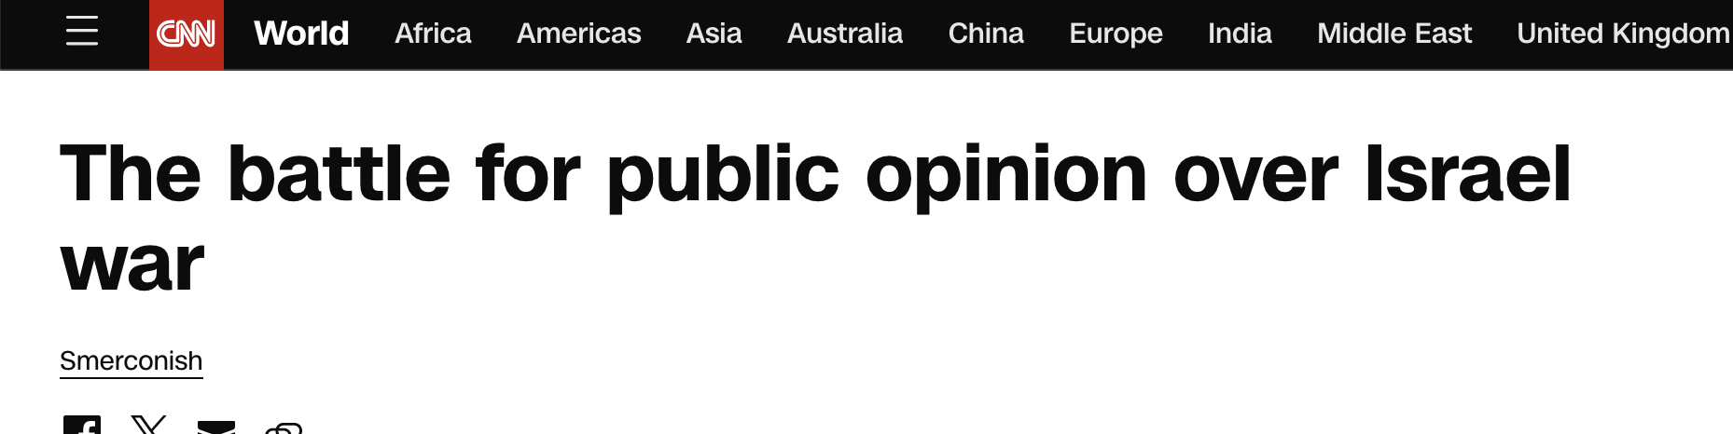
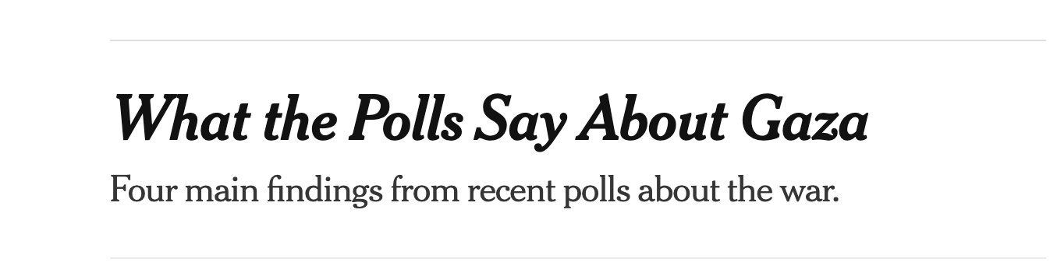
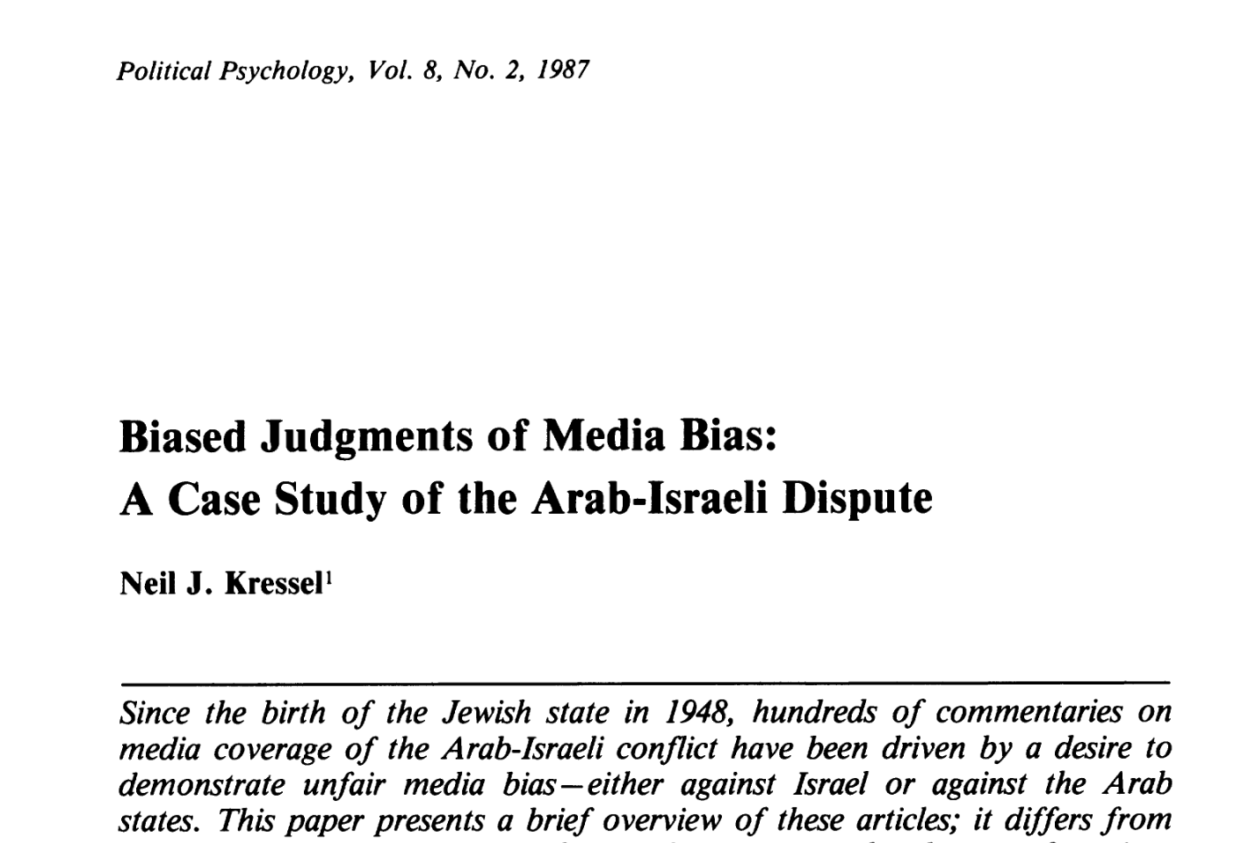
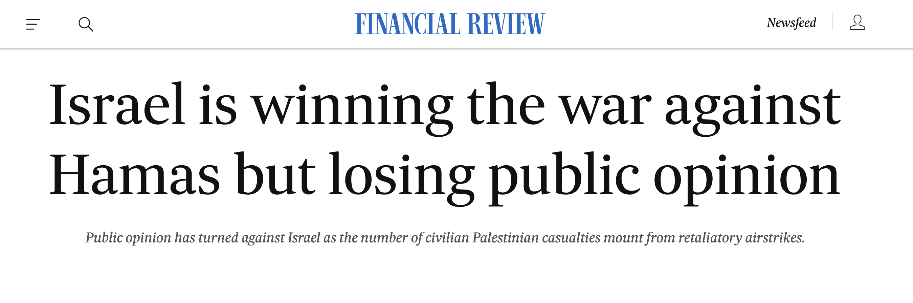
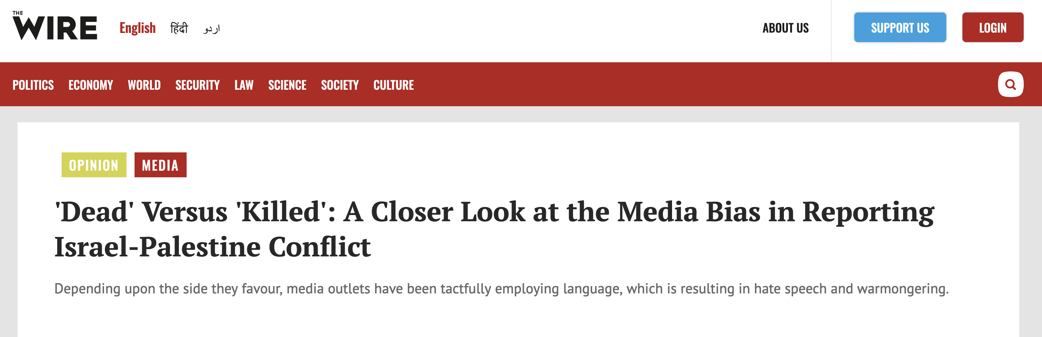
Background
Research Question: How does coverage of the Israel-Palestine conflict vary by news source and evolve over time?
Sources: CNN (2023), Kresser (1987), Financial Review (2023), NYT (2023), The Wire (2023)

Slide 5








Data Collection
Data source: LexisNexis
Search terms: israel* AND palestin*
News sources: Al Jazeera (Qatar), Die Welt (Germany), The Guardian (UK), The New York Times (USA), South China Morning Post (HK), The Straits Times (Singapore) & The Times of India (India)
Dates: 1 Sep 2023–30 Nov 2023
Corpus with over 4,000 English-language articles

Slide 6
Descriptive Analysis

Slide 7
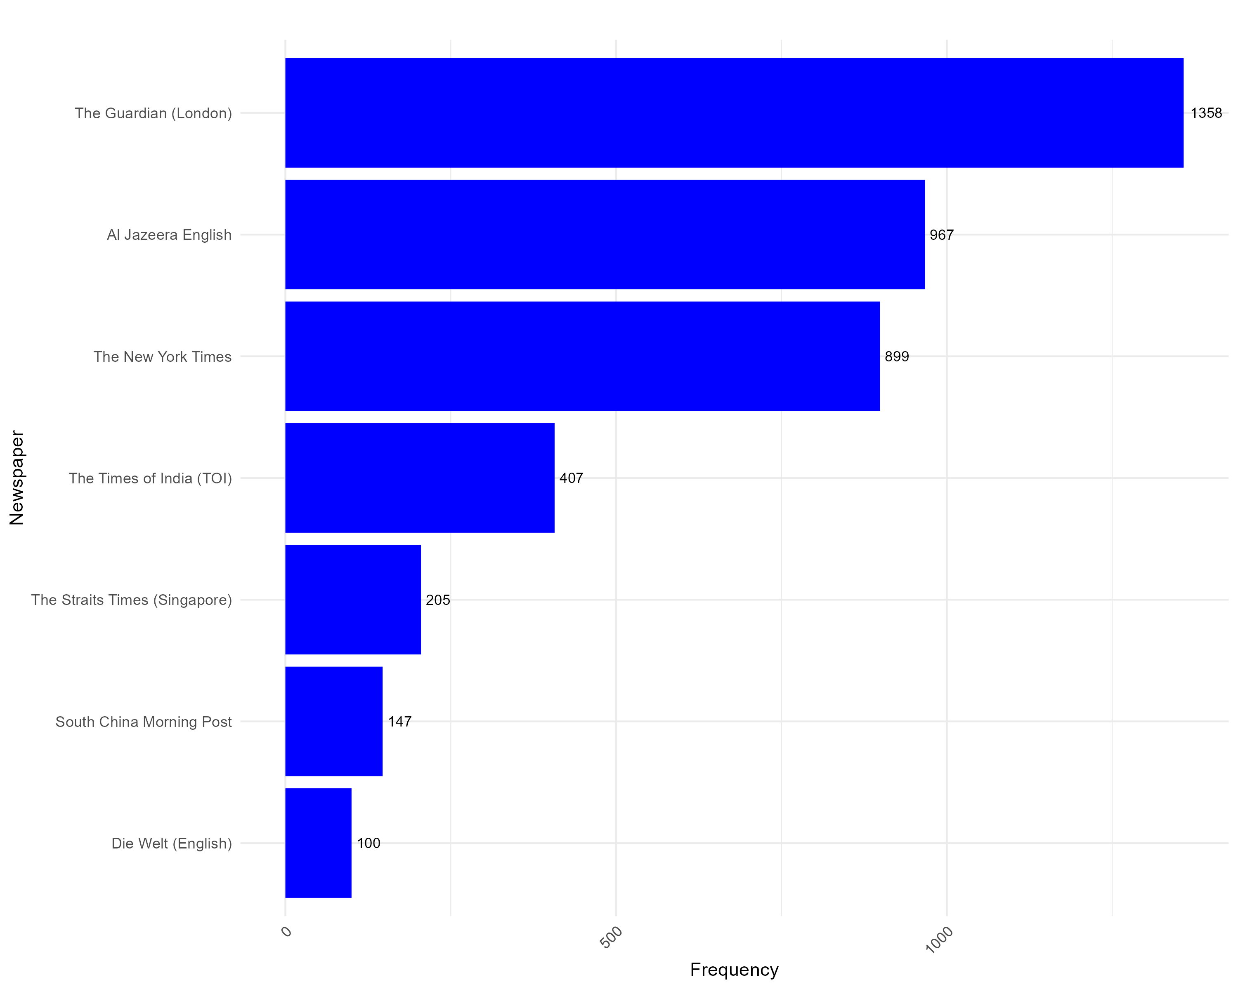
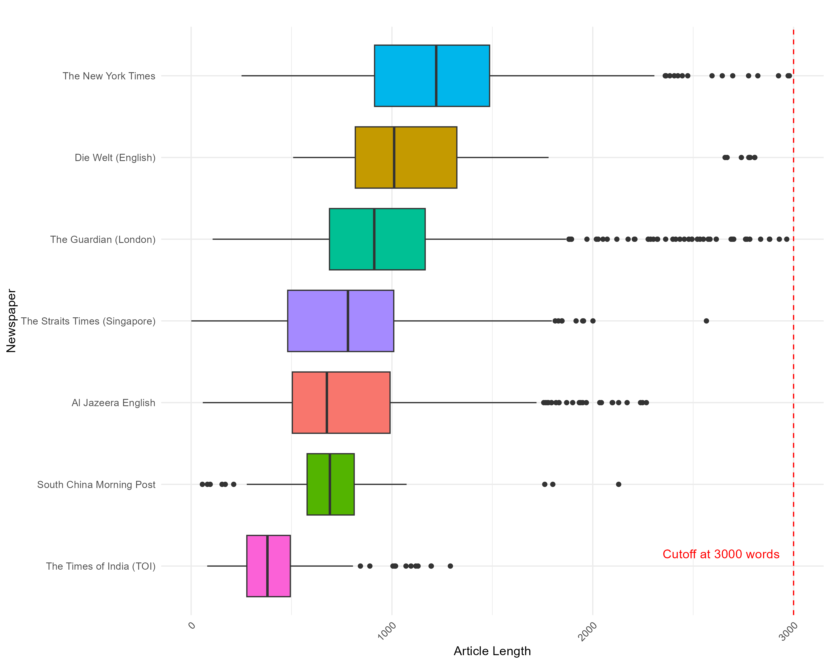
Number of articles and article length by newspaper
Frequency of Newspaper Articles by Newspaper
Distribution of Article Length by Newspaper

Slide 8
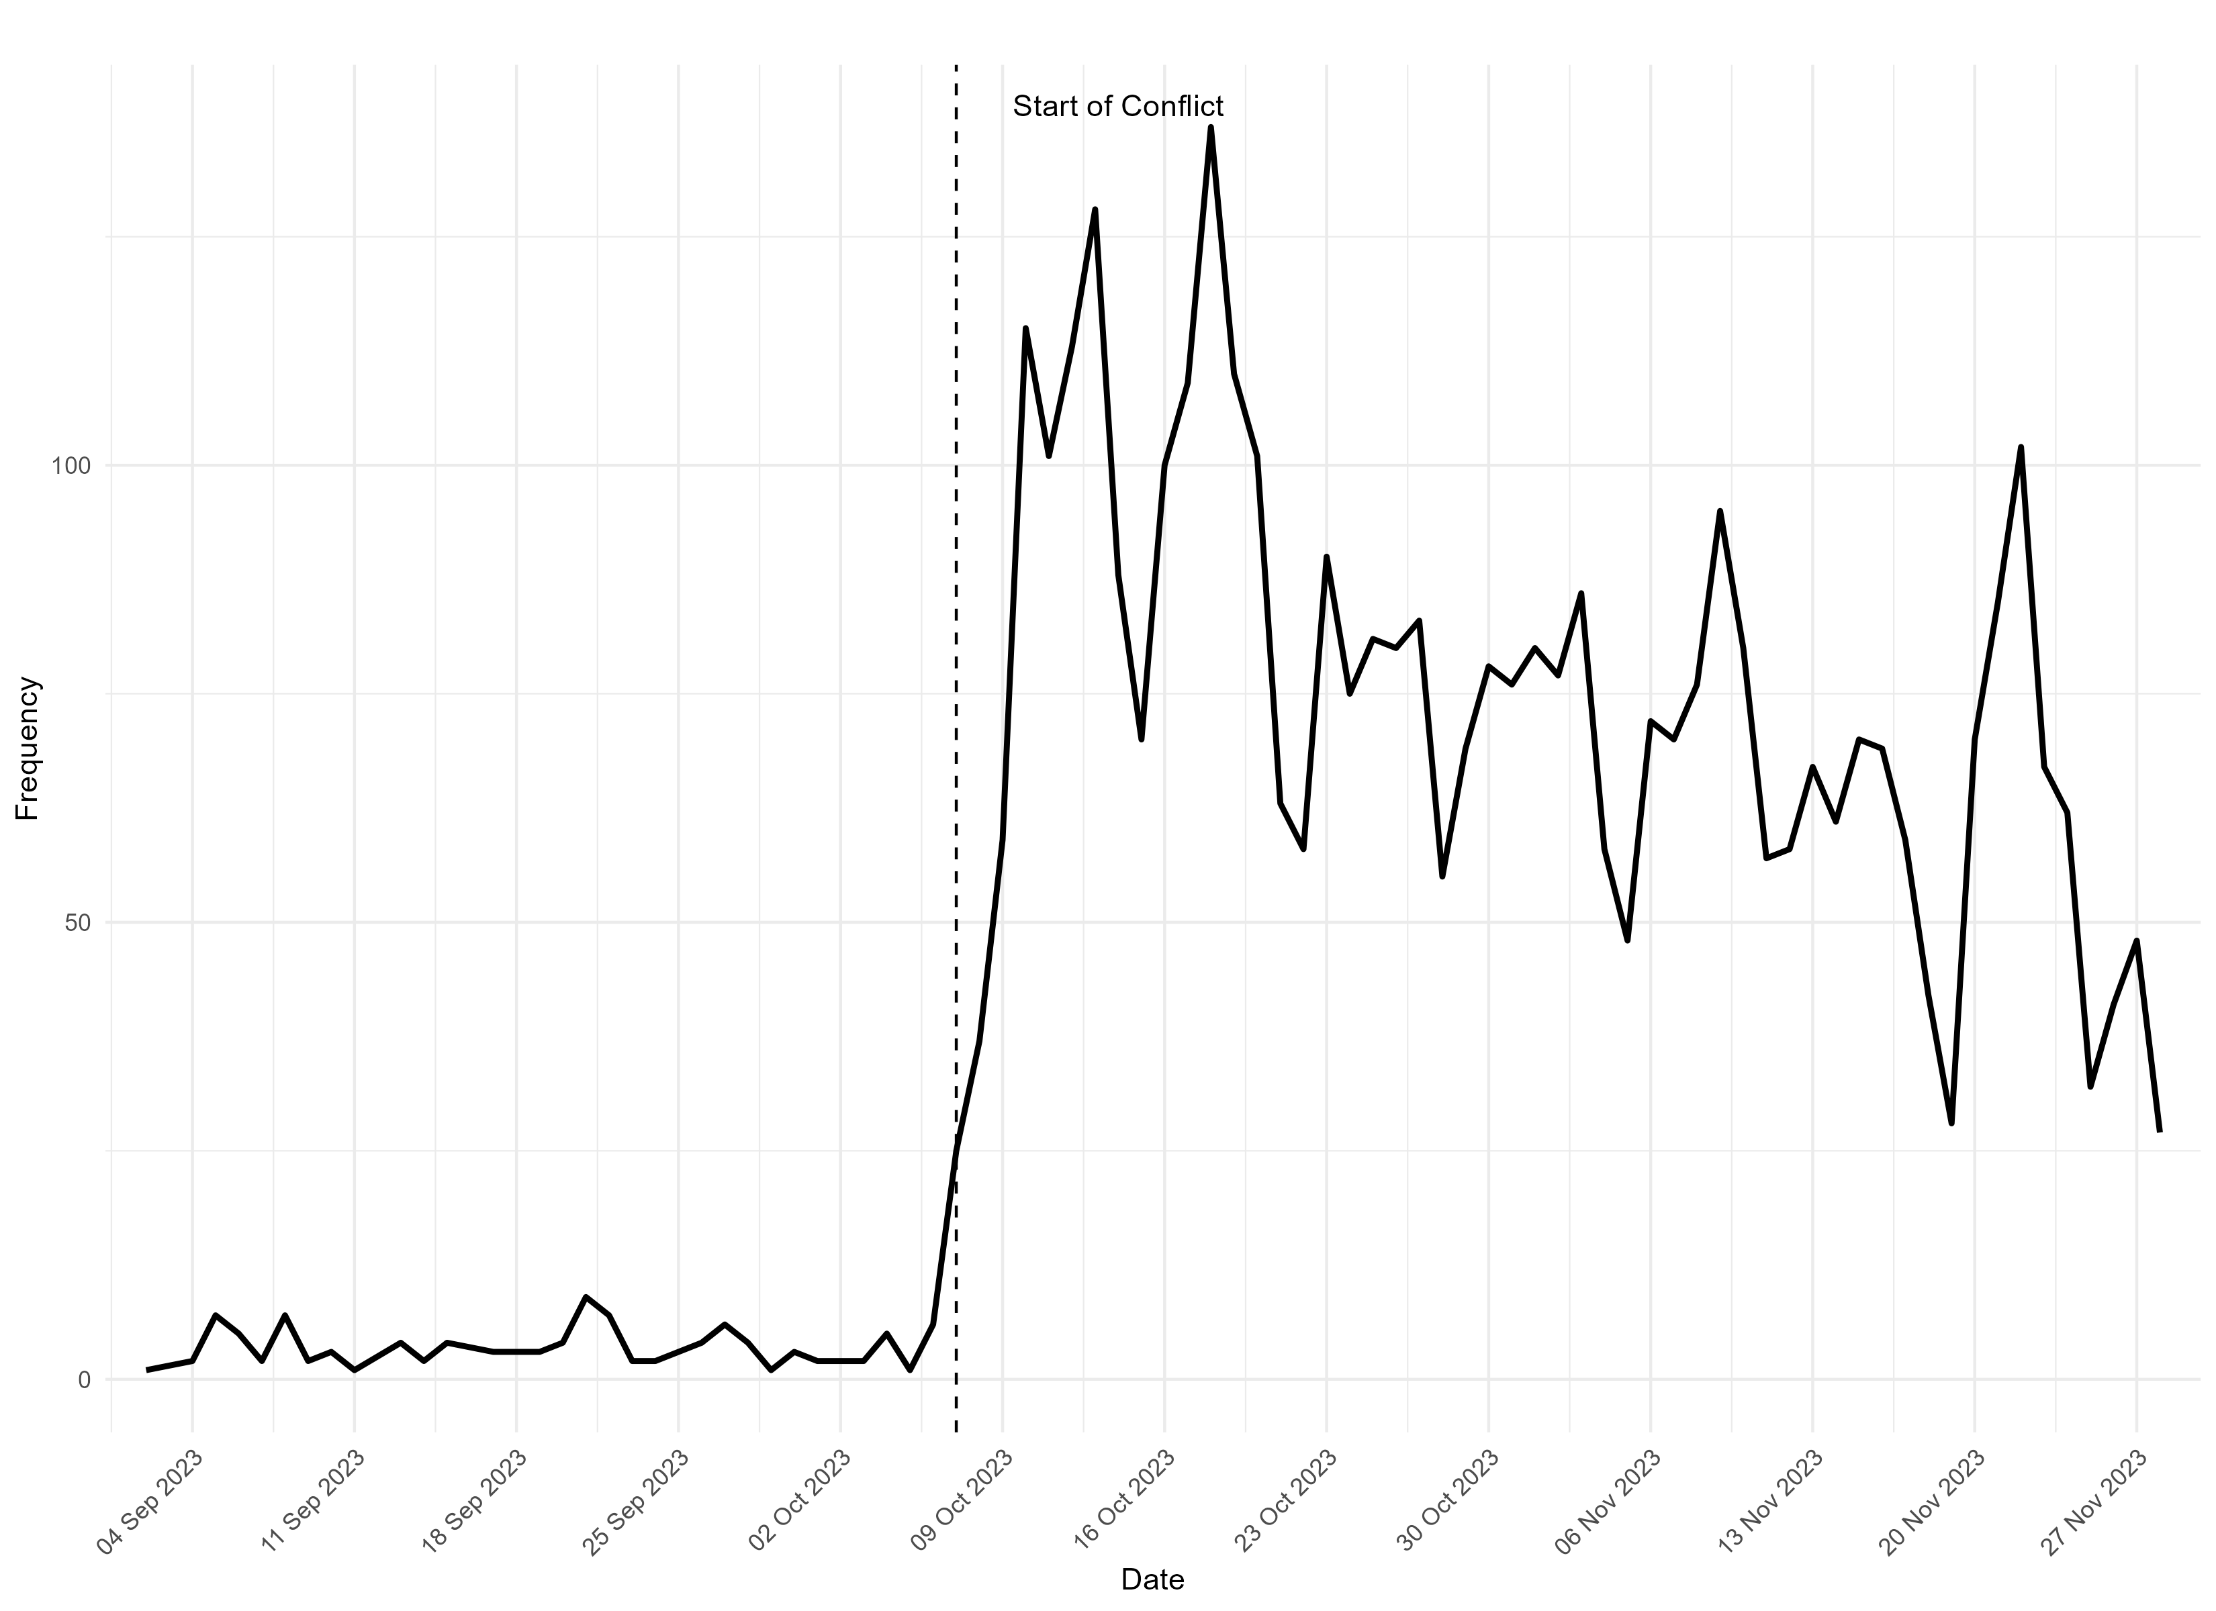
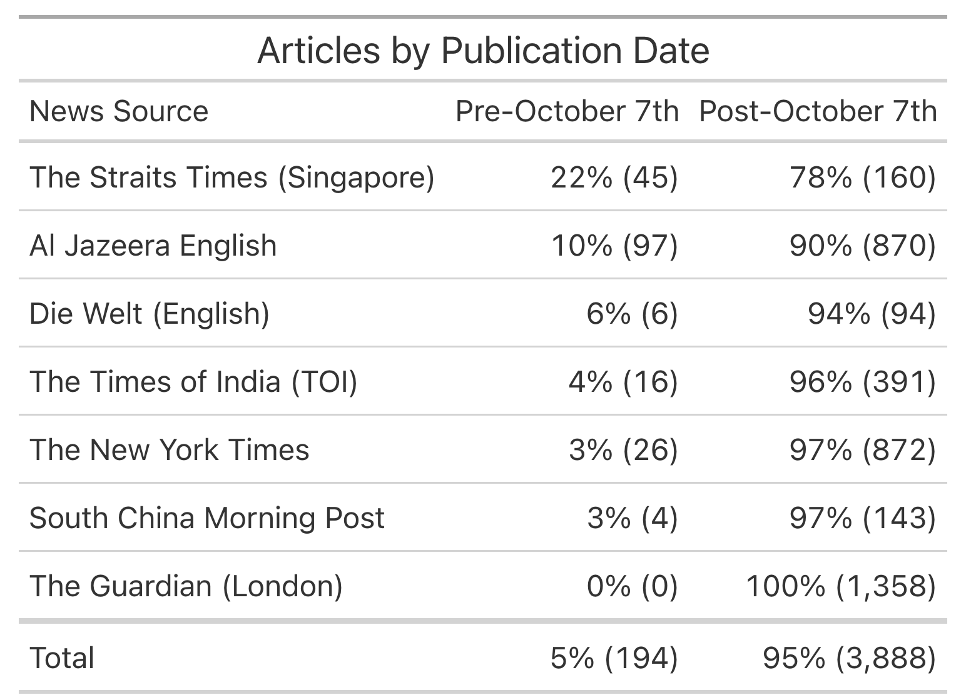
Number of articles over time
Frequency of Newspaper Articles over time
Frequency of Articles before/after onset of conflict

Slide 9
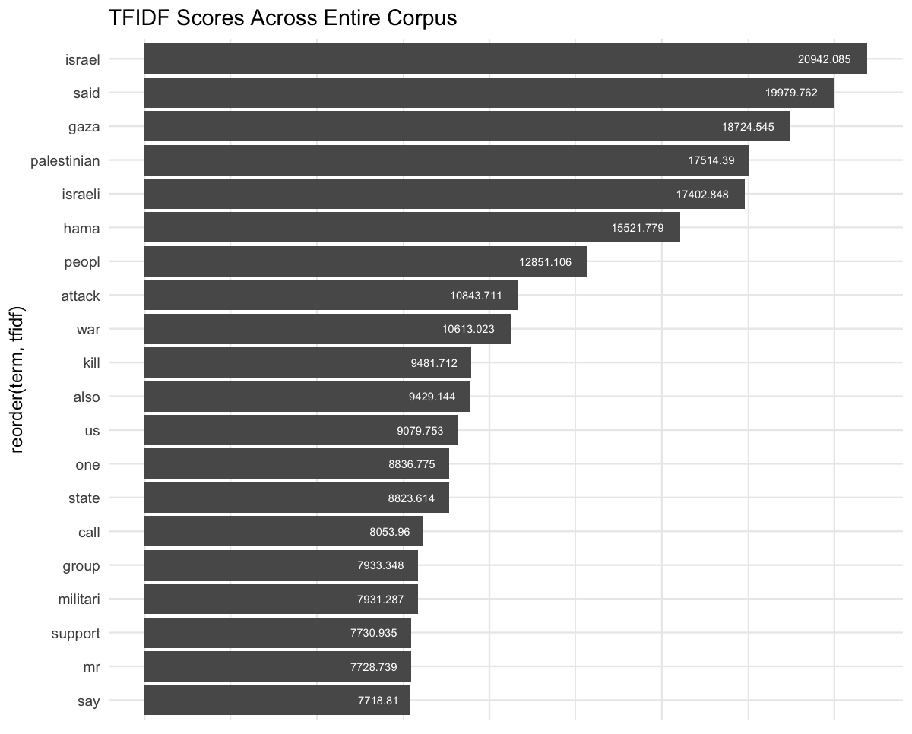
TFIDF: Most frequent words (over entire corpus)

Slide 10
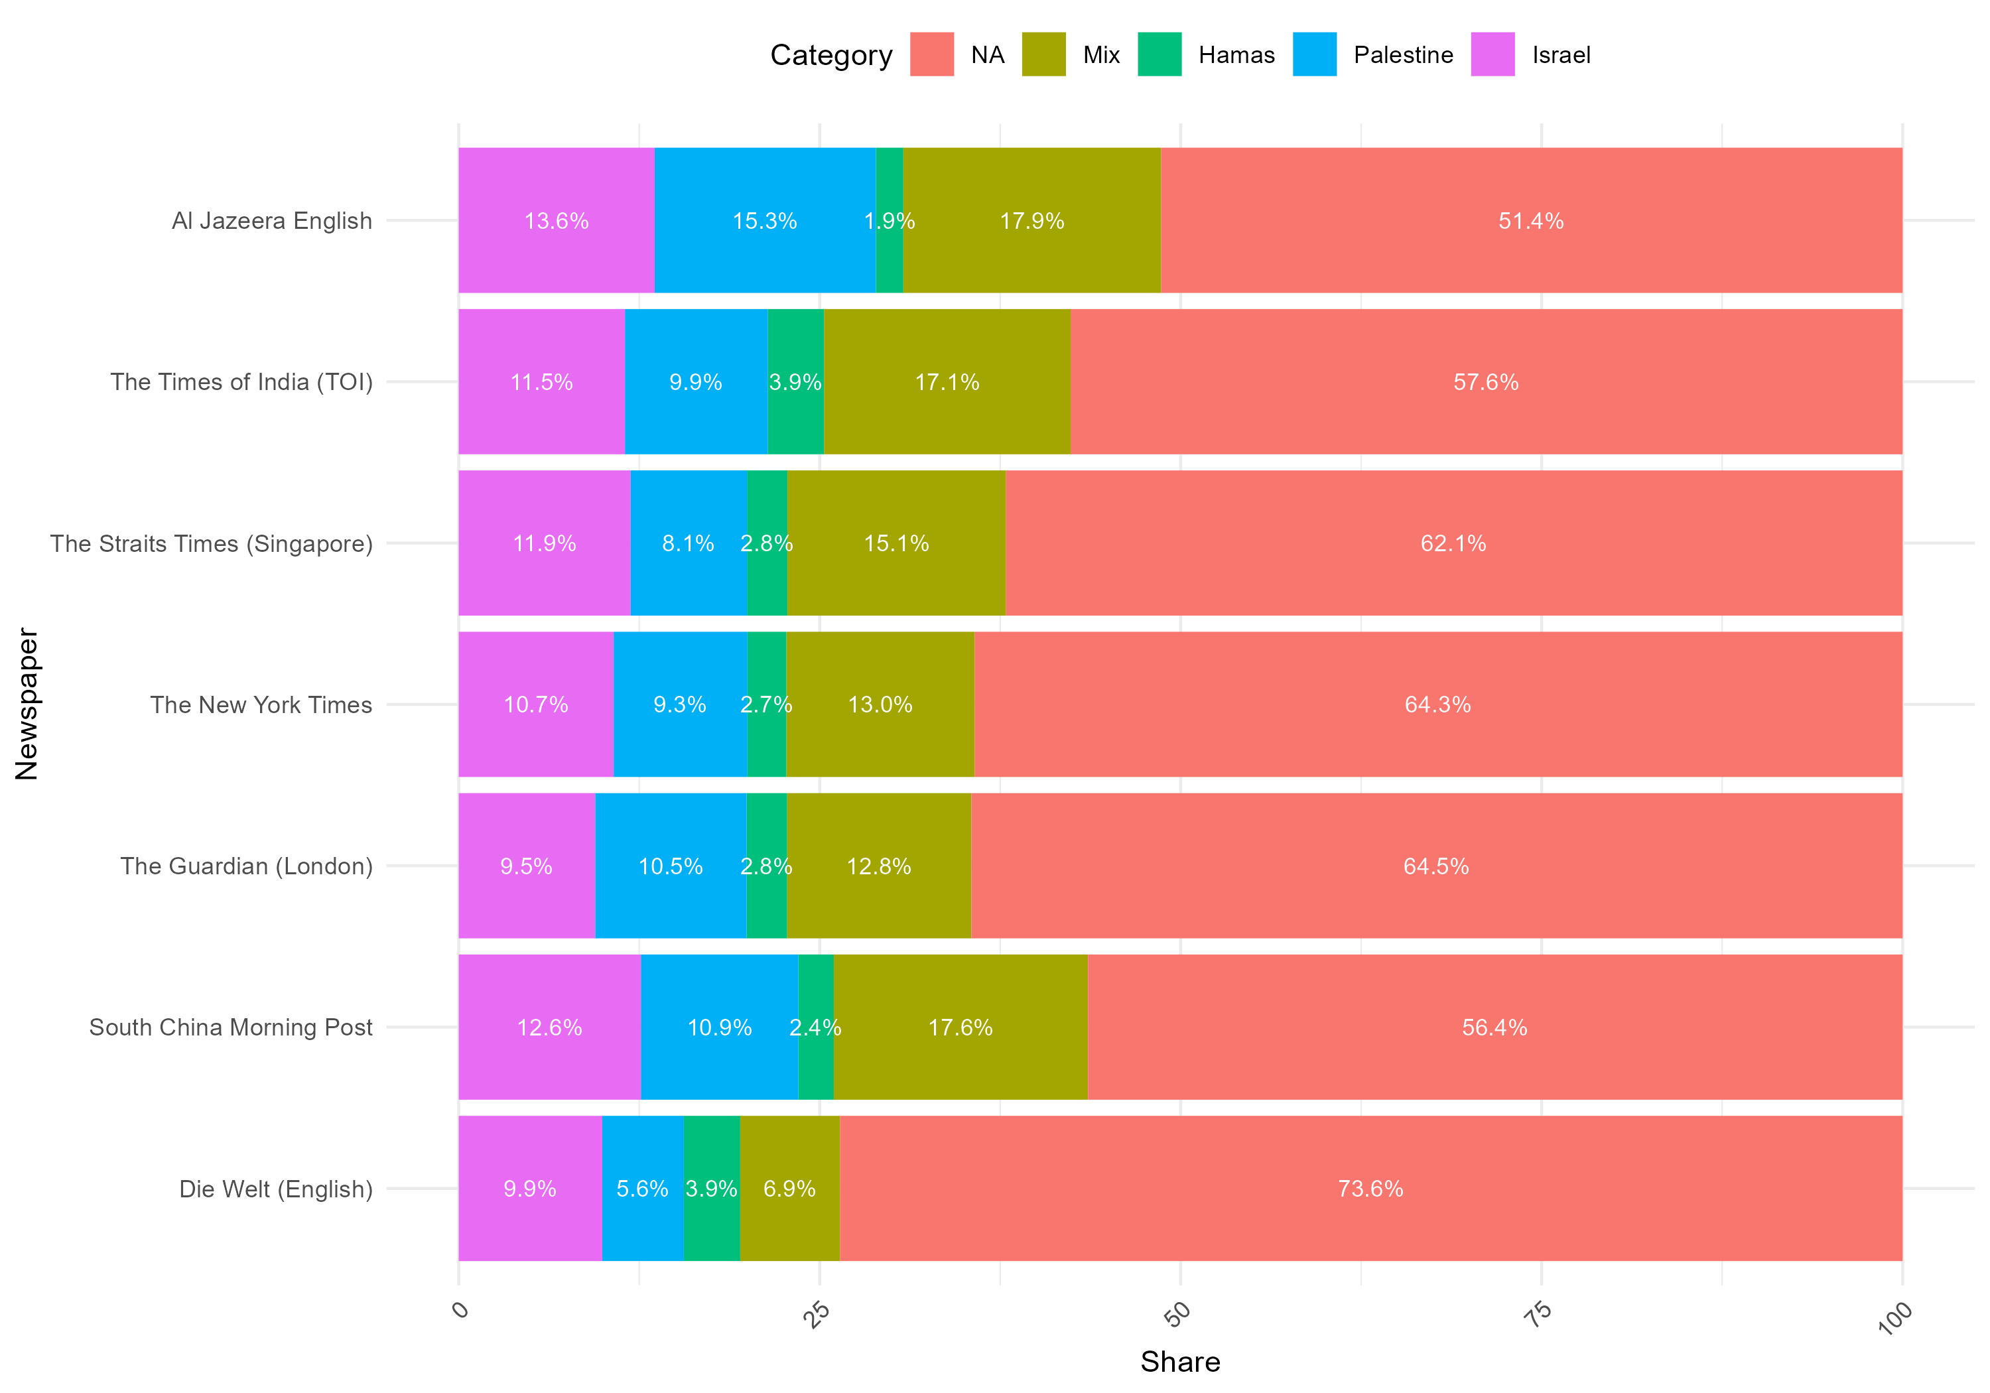


Splitting sentence into the groups “Hamas”, “Israel”, “Palestine”
Share of Groups by Newspaper
Code book for group creation
Keyword | Israel | Palestine | Hamas | Mix
“Israel”
“Palestin”
“Hamas”
“Gaza”

Slide 11
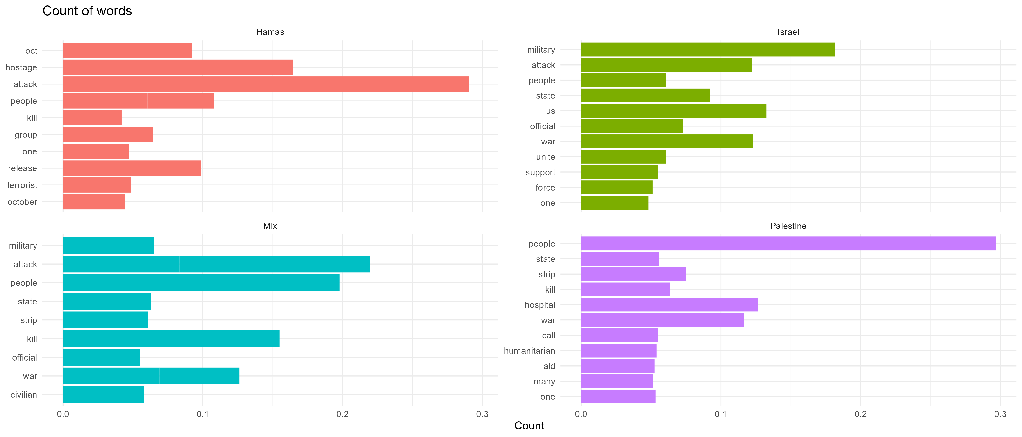
Relative Term Frequency by group
Explanation Slides
Hamas and Israel co-occur with words like „terrorist“, and „attack“ and „military“ respectively
Palestine associates co-occur with words like „hospital“ and „humanitarian“

Slide 12
Dimensionality Reduction

Slide 13
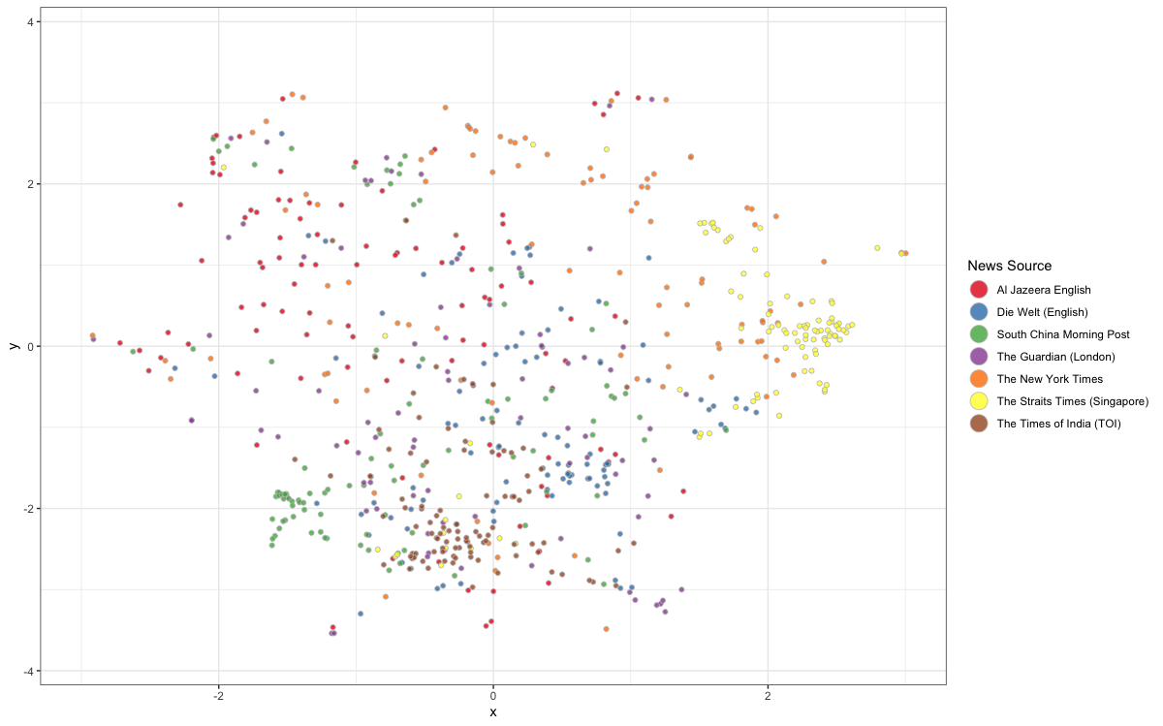
Dimensionality Reduction with UMAP
PC 2
Clustered versus dispersed news sources (on article level)
PC1

Slide 14
Topic Modelling

Slide 15
Topic Modelling
Explanation Slides
Topic 1: Highest Prob: military, war, united, people, officials, support, jewish FREX: york, netanyahu's, progressive, country's, coalition, wrote, residents Lift: afd, aaron, acceptance, accuracy, achievable, administration's, airports Score: york, invasion, officials, american, past, united, official
Topic 2: Highest Prob: military, war, hezbollah, minister, lebanon, government, iran FREX: hezbollah, lebanon, cabinet, deal, war, lebanese, ceasefire Lift: gantz, harb, played, australians, blanford, slim, historical Score: hezbollah, war, military, lebanon, hostages, australians, iran
Topic 3: Highest Prob: jewish, forces, attack, anti, killed, jerusalem, captives FREX: captives, jerusalem, forces, jewish, vwp, anti, idf Lift: hatred, imran, armenian, patriarchate, semitism, aly, spitting Score: captives, jewish, aly, vwp, forces, jerusalem, anti
Topic 4: Highest Prob: military, war, united, people, officials, support, biden FREX: it’s, country’s, yesterday, netanyahu’s, don’t, china's, hong Lift: accountable, achieved, acts, amman, angry, argument, beijing’s Score: it’s, official, officials, united, invasion, american, past
Topic 5: Highest Prob: al, hospital, arab, saudi, international, countries, india FREX: ship, houthis, syrian, australian, modi, greece, cargo Lift: syrian, allgemeine, dische, fc, bakery, kastoni, mustafa Score: india, normalisation, ship, houthis, al, romann, greece
Topic 6: Highest Prob: biden, people, support, president, bank, west, attacks FREX: biden, president, police, support, settlers, occupied, mcdonald’s Lift: sq, fools, god, hagee, hummel, zanuta, parsi Score: biden, support, louk's, biden's, god, lew, president
Highest Prob (Probability): words that have the highest likelihood of being associated with a Topic
FREX (Frequency Expected): emphasizes the combination of high frequency and unexpectedness to pinpoint distinctive words within a topic
Lift: Measures the strength of association between a word and a topic
Score: combination of both frequency and lift.
Hyper-parameters:
K- classification = 6
n minimum word frequency = 2
Topics Classified:
US Military
Hezbollah
Anti-Semitism
China/US
International Community
West Bank/Occupation

Slide 16
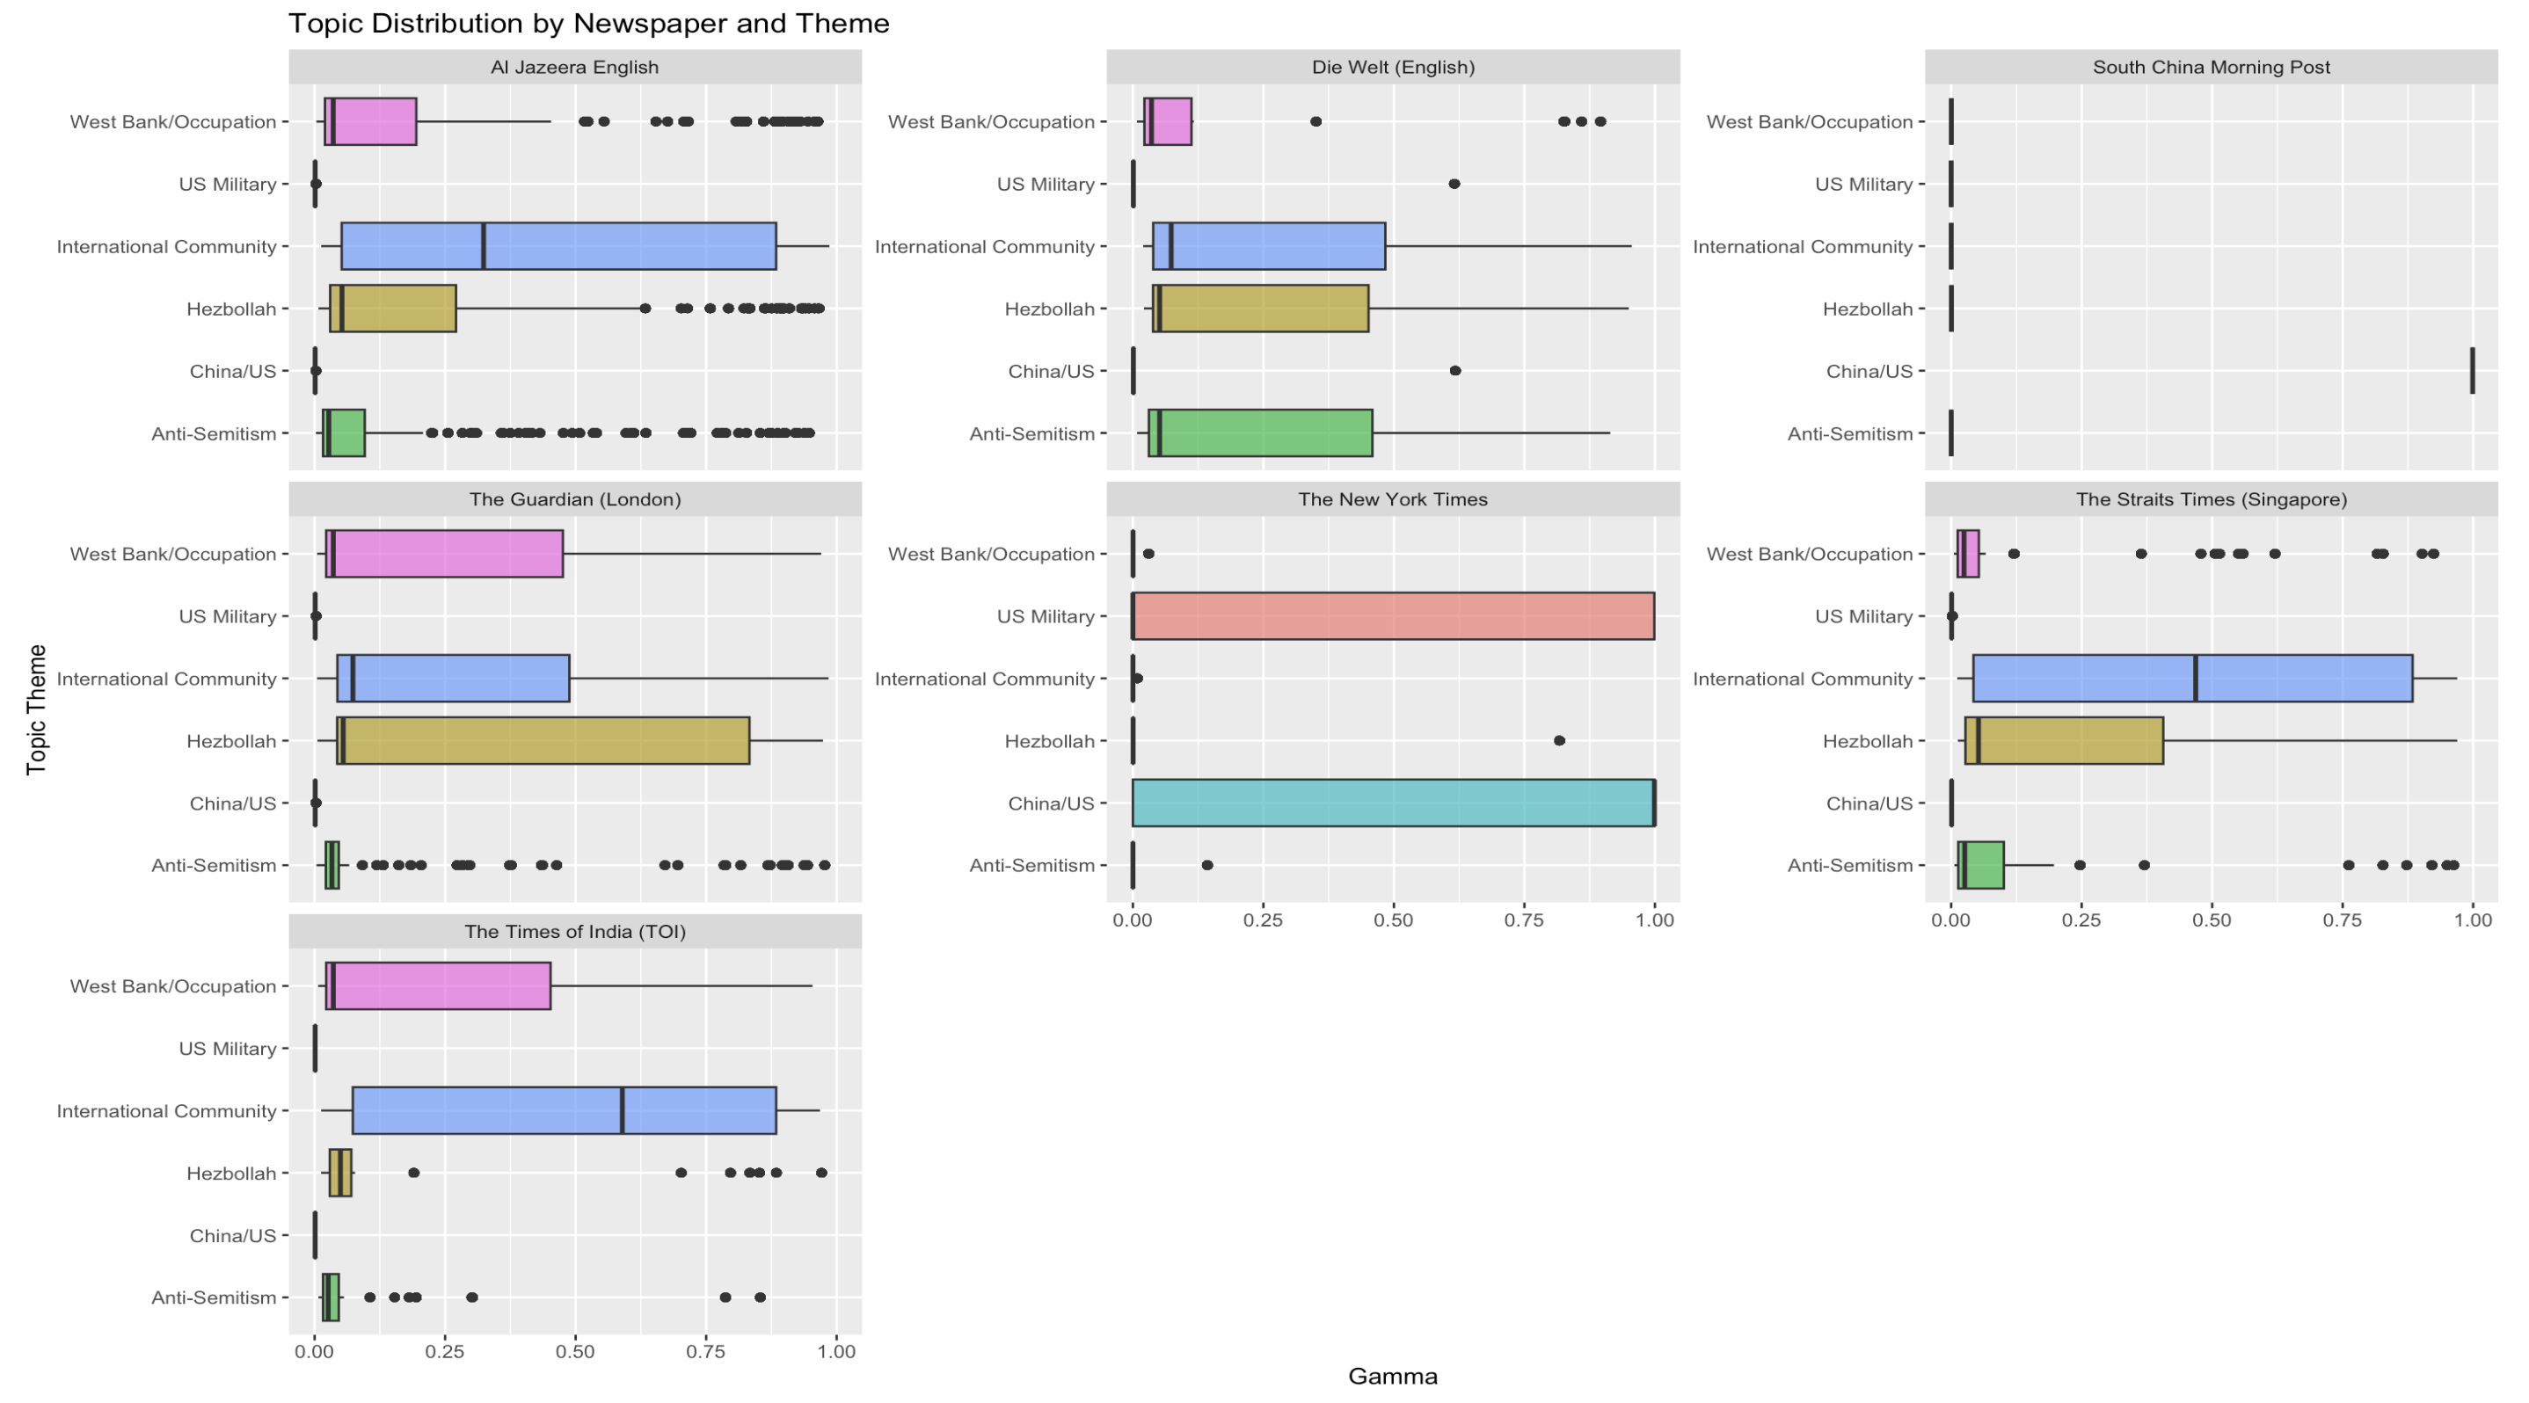
Topic Modelling – ‘Israel’
Explanation Slides

Slide 17
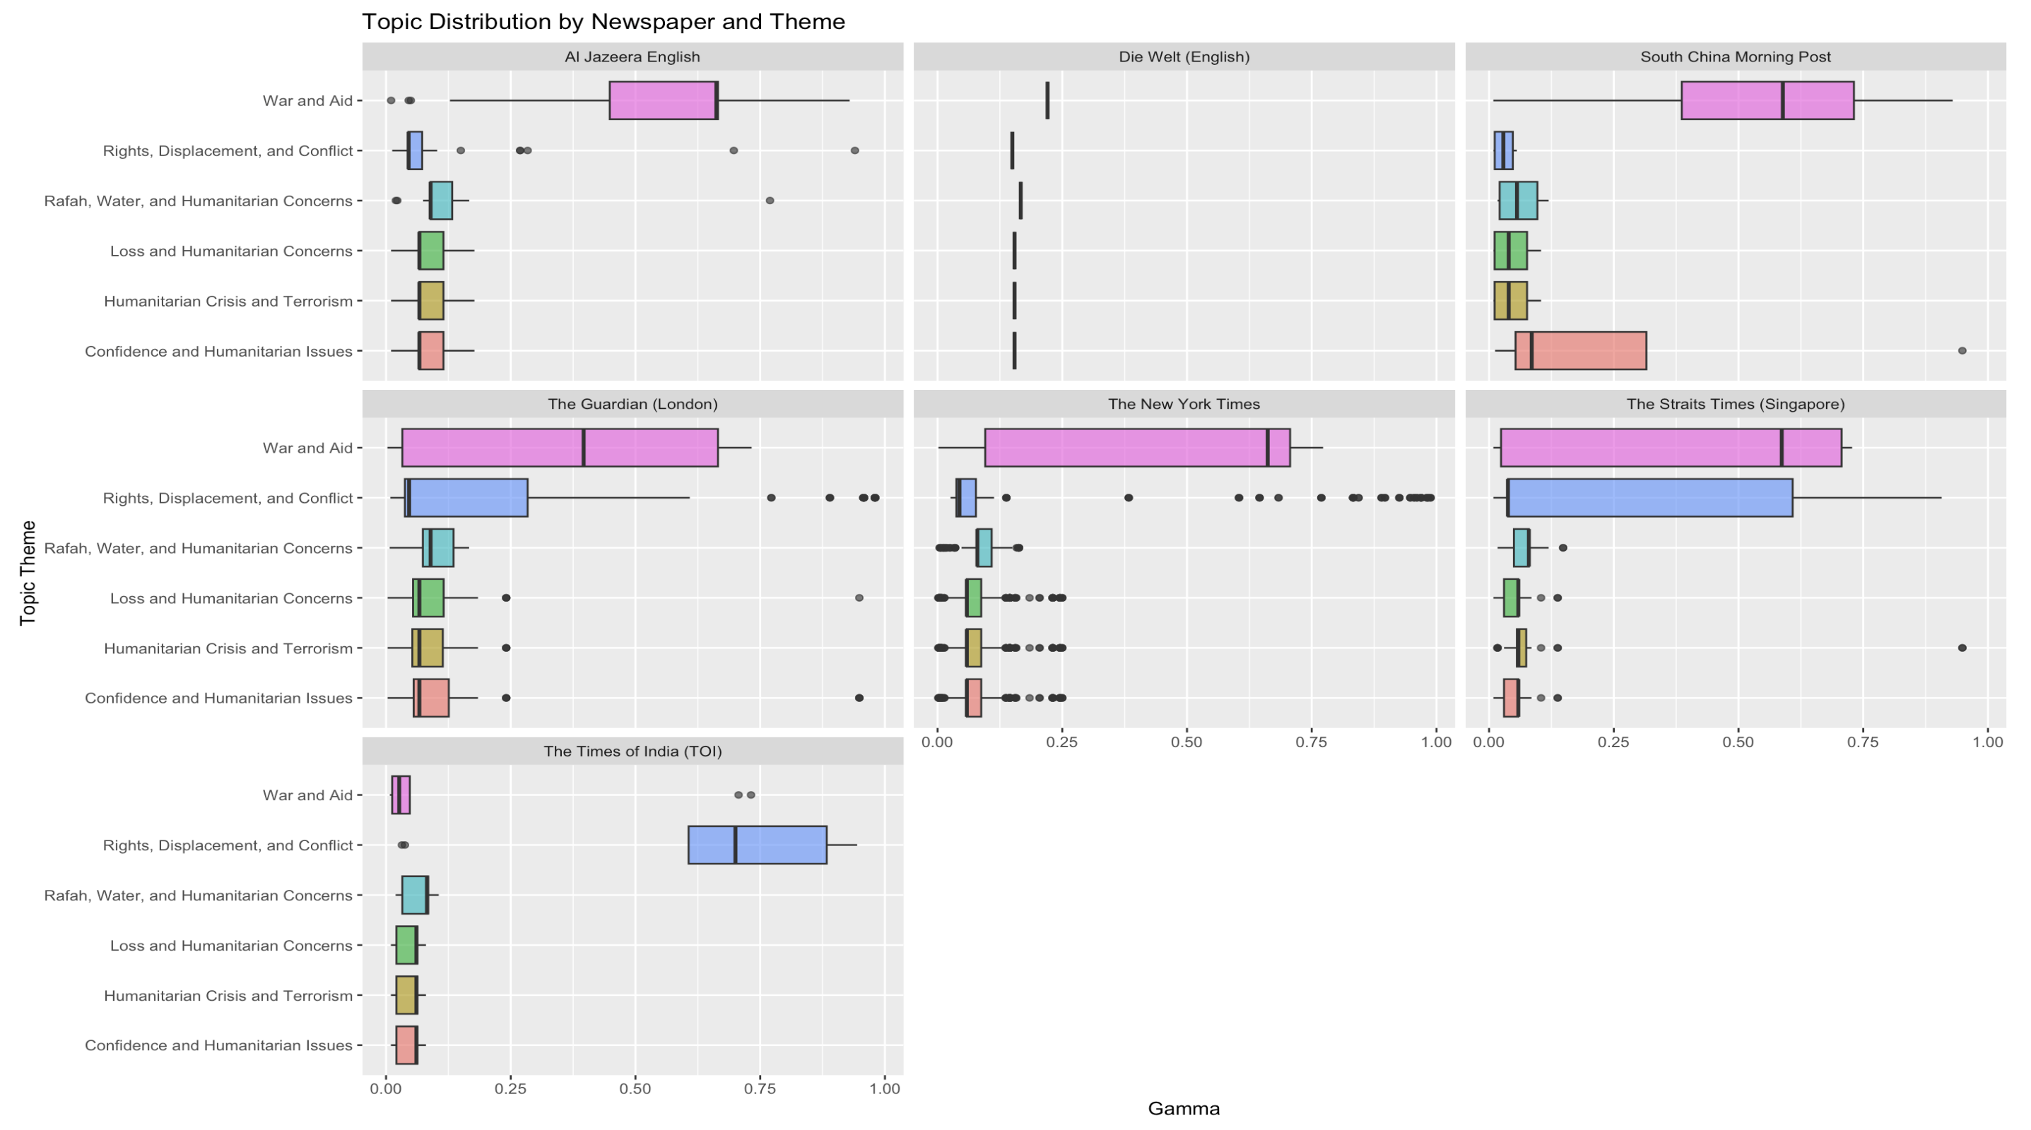
Topic Modelling – ‘Palestine’
Explanation Slides

Slide 18
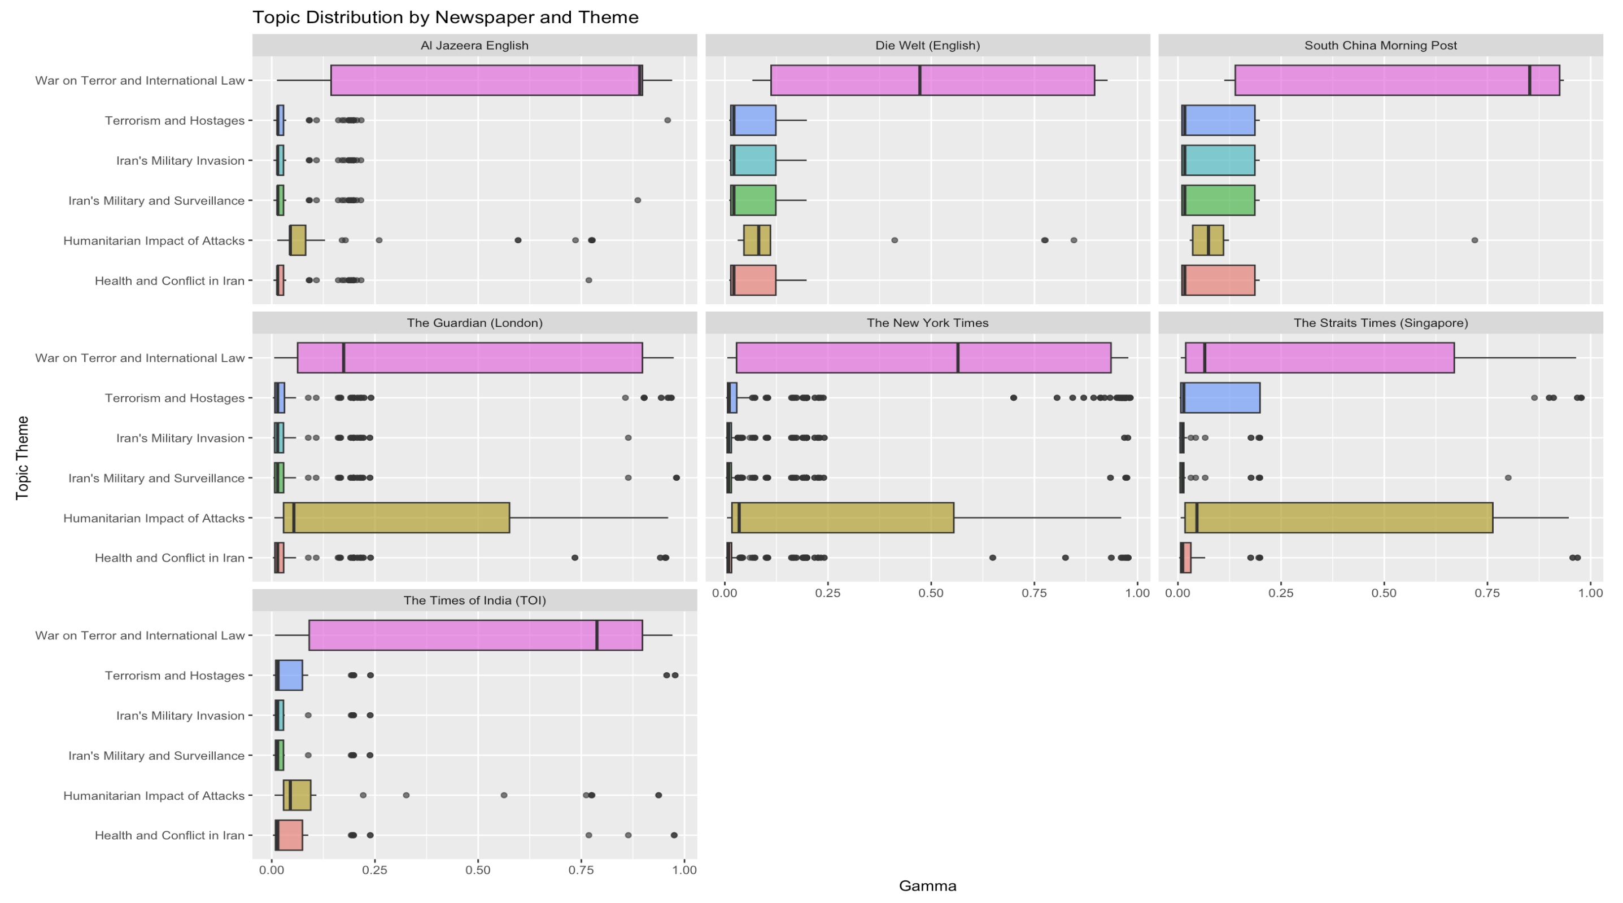
Topic Modelling – ‘Hamas’
Explanation Slides

Slide 19
Sentiment Analysis

Slide 20
VADER: Measuring Polarity
Score | Sentence
0.925 | “Wang also reiterated Beijing's support for the two-state solution, saying the Middle East would be able to enjoy lasting peace and Israel would have more lasting security only when it was fully implemented."
0.915 | “We believe that each of these efforts [to protect Palestinian civilians and increase aid into Gaza would be facilitated by humanitarian pauses, by arrangements on the ground that increase security for civilians and permit the more effective and sustained delivery of humanitarian assistance, the top US diplomat told journalists."
0.832 | “Afterman said that China did have the opportunity to play a big role in advancing regional stability, for instance by helping secure the release of some of the more than 200 hostages that Hamas holds."
Positive
Score | Sentence
-0.988 | "… the brutal terror attack that killed more than 1,400 Israelis, most of them civilians."
-0.973 | "Biden said he was shocked and sickened by the stabbing of a six-year-old Palestinian boy in Illinois, with a 71-year-old man charged with murder and a hate crime."
-0.968 | “Noiya's death takes the number of Britons killed in the Hamas attack to at least 10, with another six missing, some of whom are feared to be among the dead or kidnapped."
Negative

Slide 21
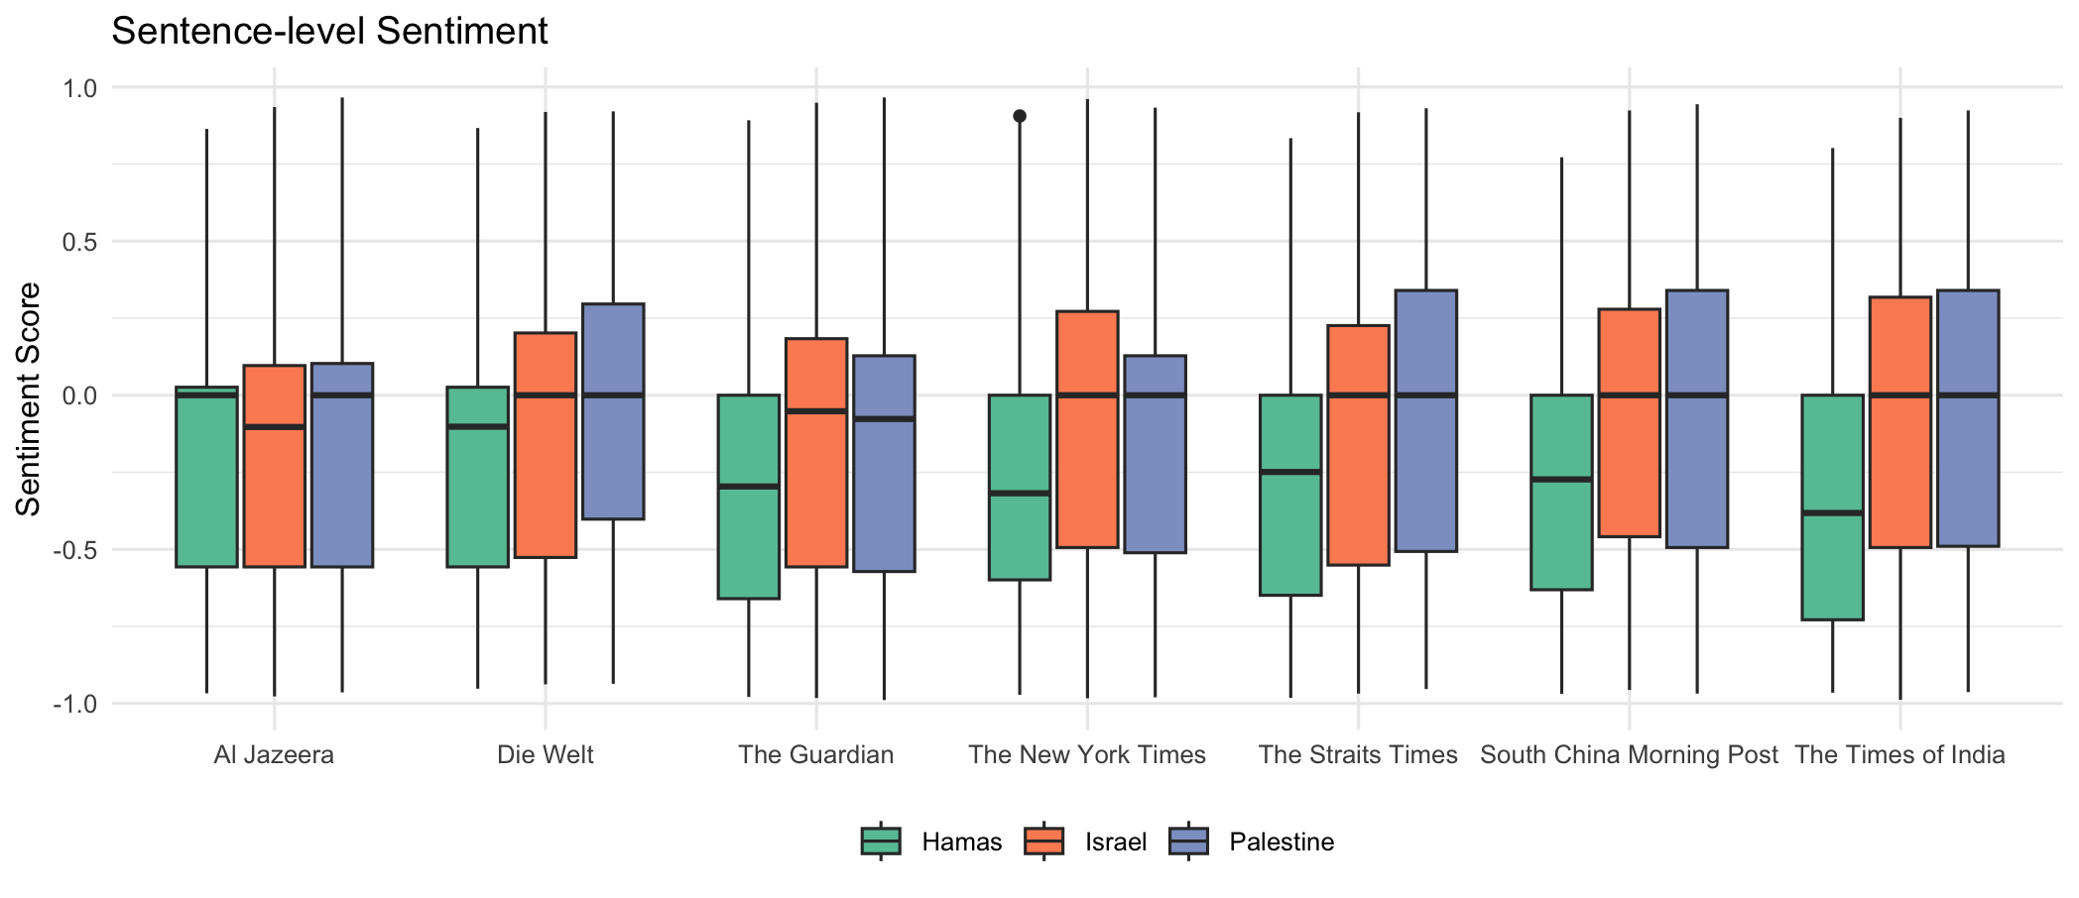
Polarity scores by Newspaper
Explanation Slides
Box and whisker plot for each newspaper and label
In general, mostly negative sentiments (perhaps because it’s in the context of war reports)
In general, distribution of sentiments associated with Palestine is higher for most newspapers although for The Guardian and The New York Times this is higher for Israel
For all newspapers, Hamas associated sentiments are the least among the 3 labels, though across newspapers, the median value varies with the median being the highest in Al Jazeera and the lowest in TOI.

Slide 22
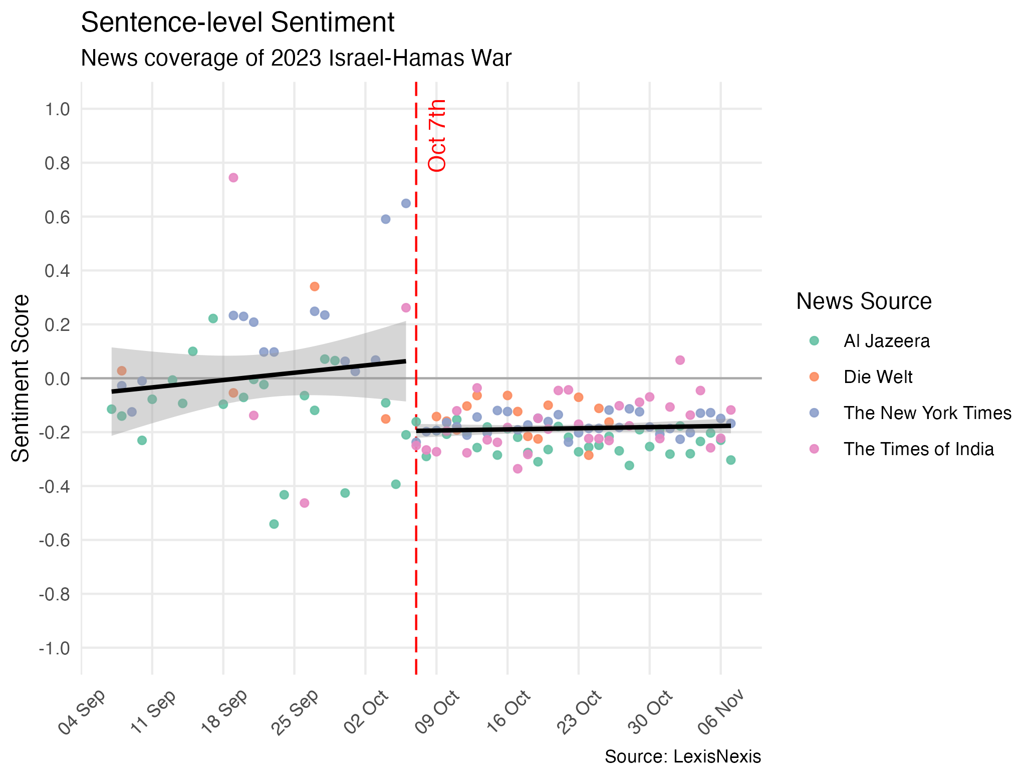
Explanation Slides

Slide 23
NRC: Measuring Emotion
Sentiment | Score | Sentence
Anger | 8 | "These are anti-Jewish racist incidents and hate crimes in which Jewish people, property and institutions are singled out for hate, including death threats and abuse."
Trust | 8 | "“So long as there is a United States Senate, the people of Israel will never stand alone,” Senator Chuck Schumer, the majority leader, said in a floor speech before the vote, pledging that “the Senate will back up this resolution with real, swift, decisive action and resources."
Fear | 7 | "Israel’s order to empty 23 hospitals treating over 2,000 patients in Gaza presents health workers with a horrifying choice: force those in their care to make a journey that for many will be their last or stay and treat their patients under the impending threat of bombardment."
Disgust | 6 | "The terrorist attack by Hamas against Israelis -- the worst massacre of Jewish people since the Holocaust -- was horrid, barbaric and inexcusable."
Anticipation | 5 | "…an injured man lies inside an ambulance waiting at the Rafah border crossing in the southern Gaza Strip before receiving medical care in Egypt."
Joy | 5 | "She only went to a party, to a festival, to have some fun, she said tearfully, clutching a picture of her daughter who was kidnapped from the Supernova music festival on the Gaza border."
Sadness | 5 | "A Red Cross mission has described scenes of chaos and exhaustion in the face of the total blockade by Israel, a critical fuel shortage and relentless bombing."
Surprise | 4 | "… warned of a “looming humanitarian catastrophe” as the Israel Defence Forces ordered civilians to urgently leave the Northern part of Gaza."

Slide 24
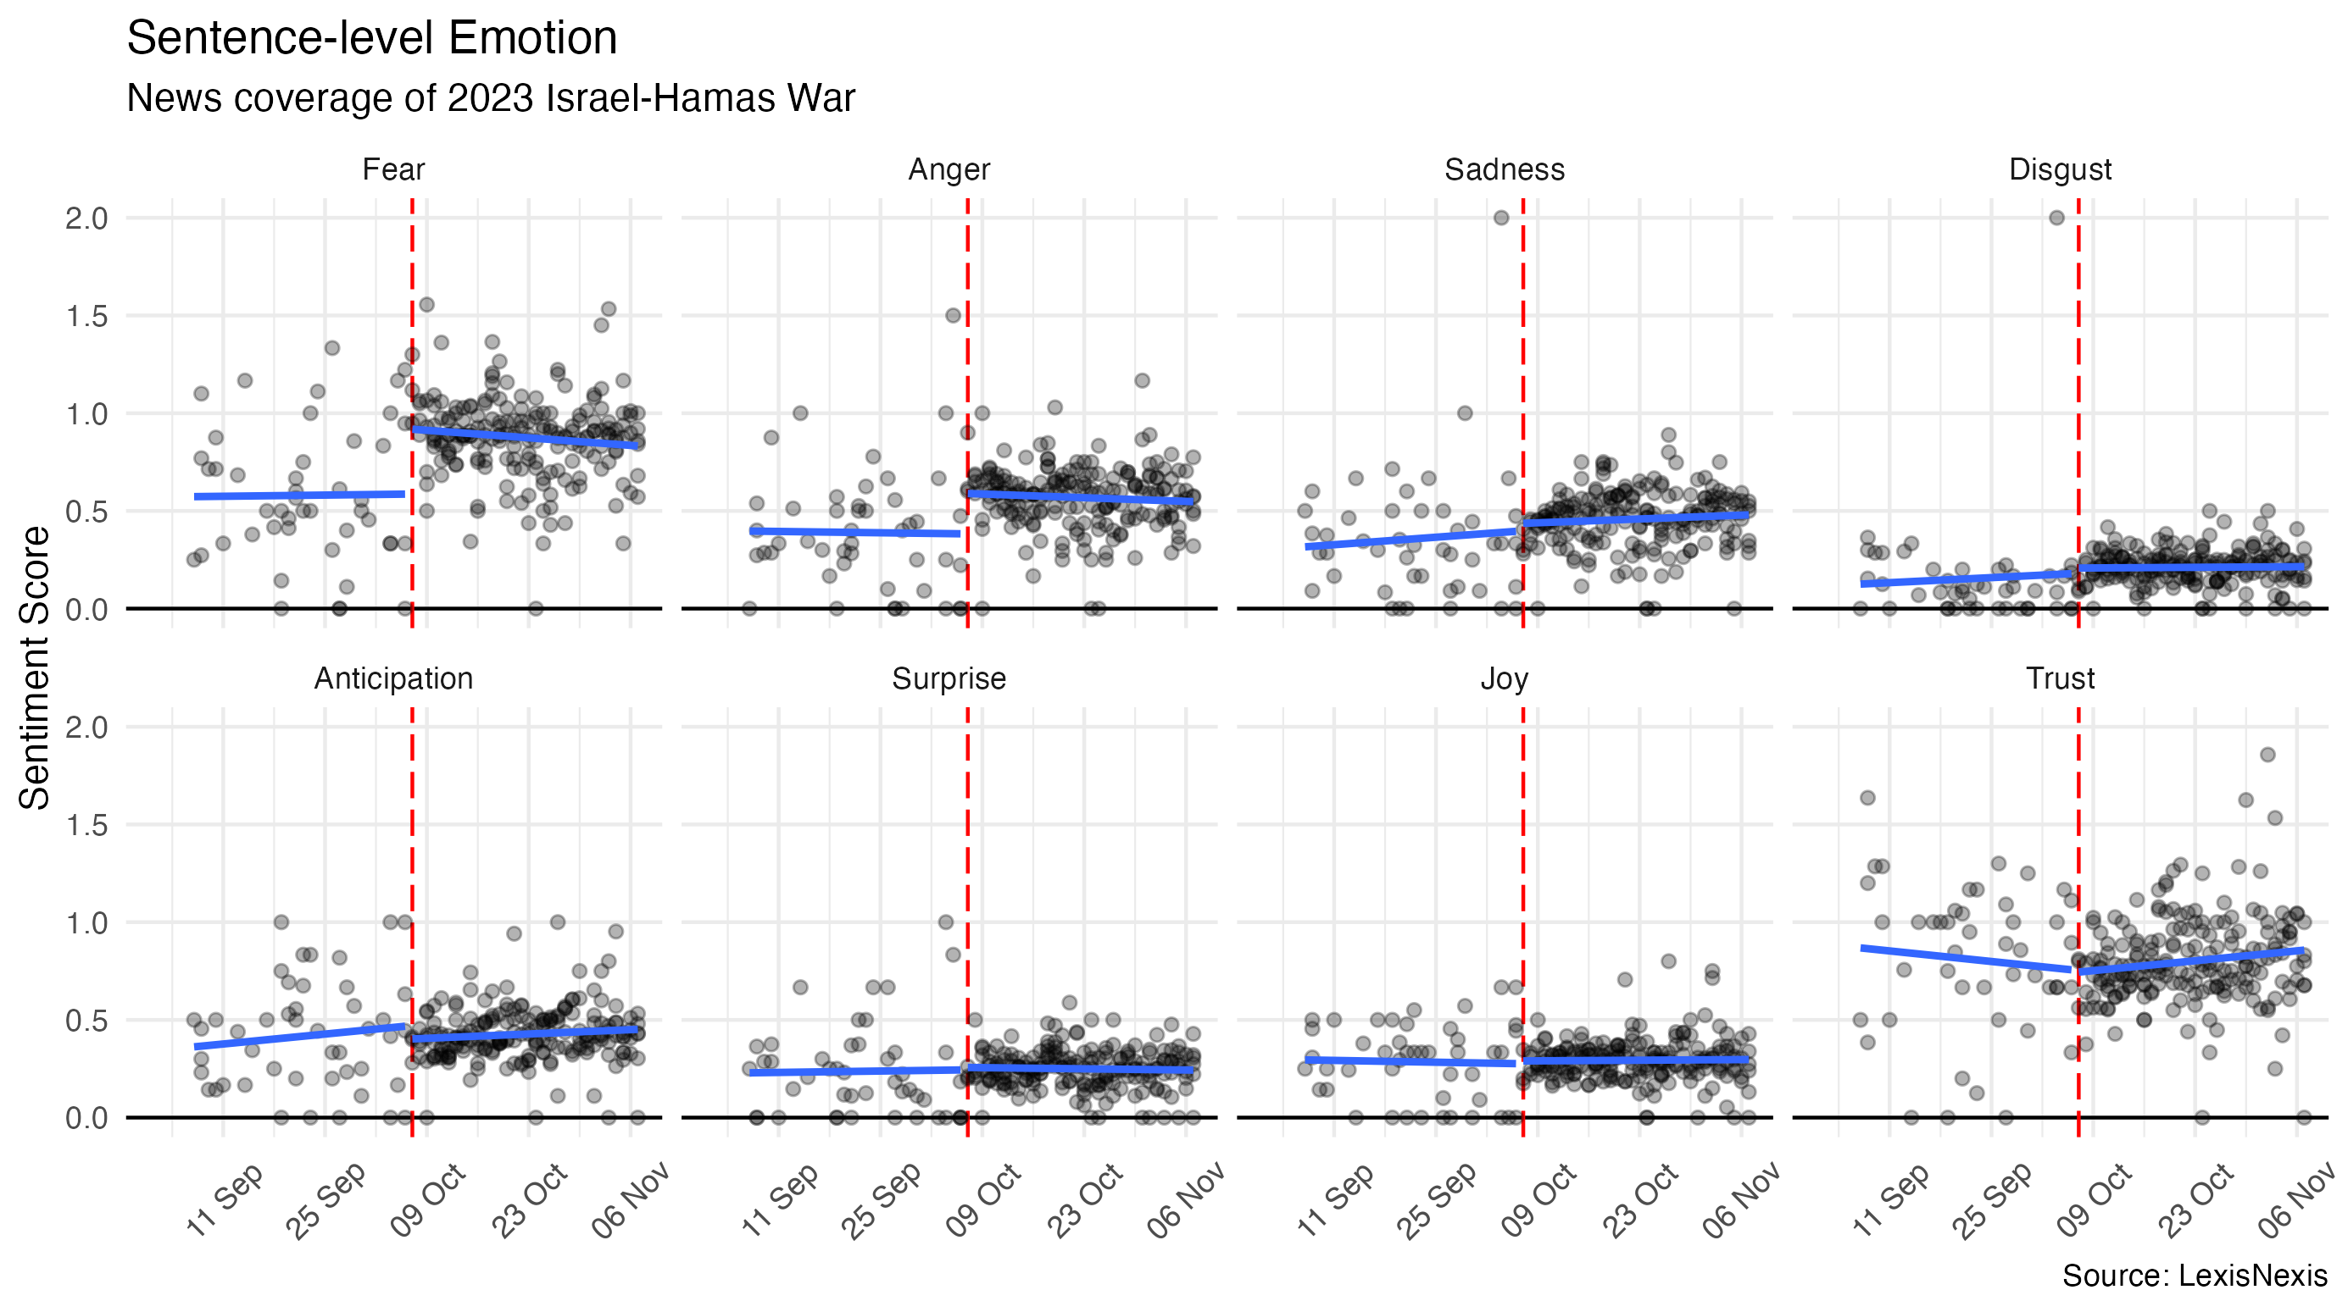

Slide 25
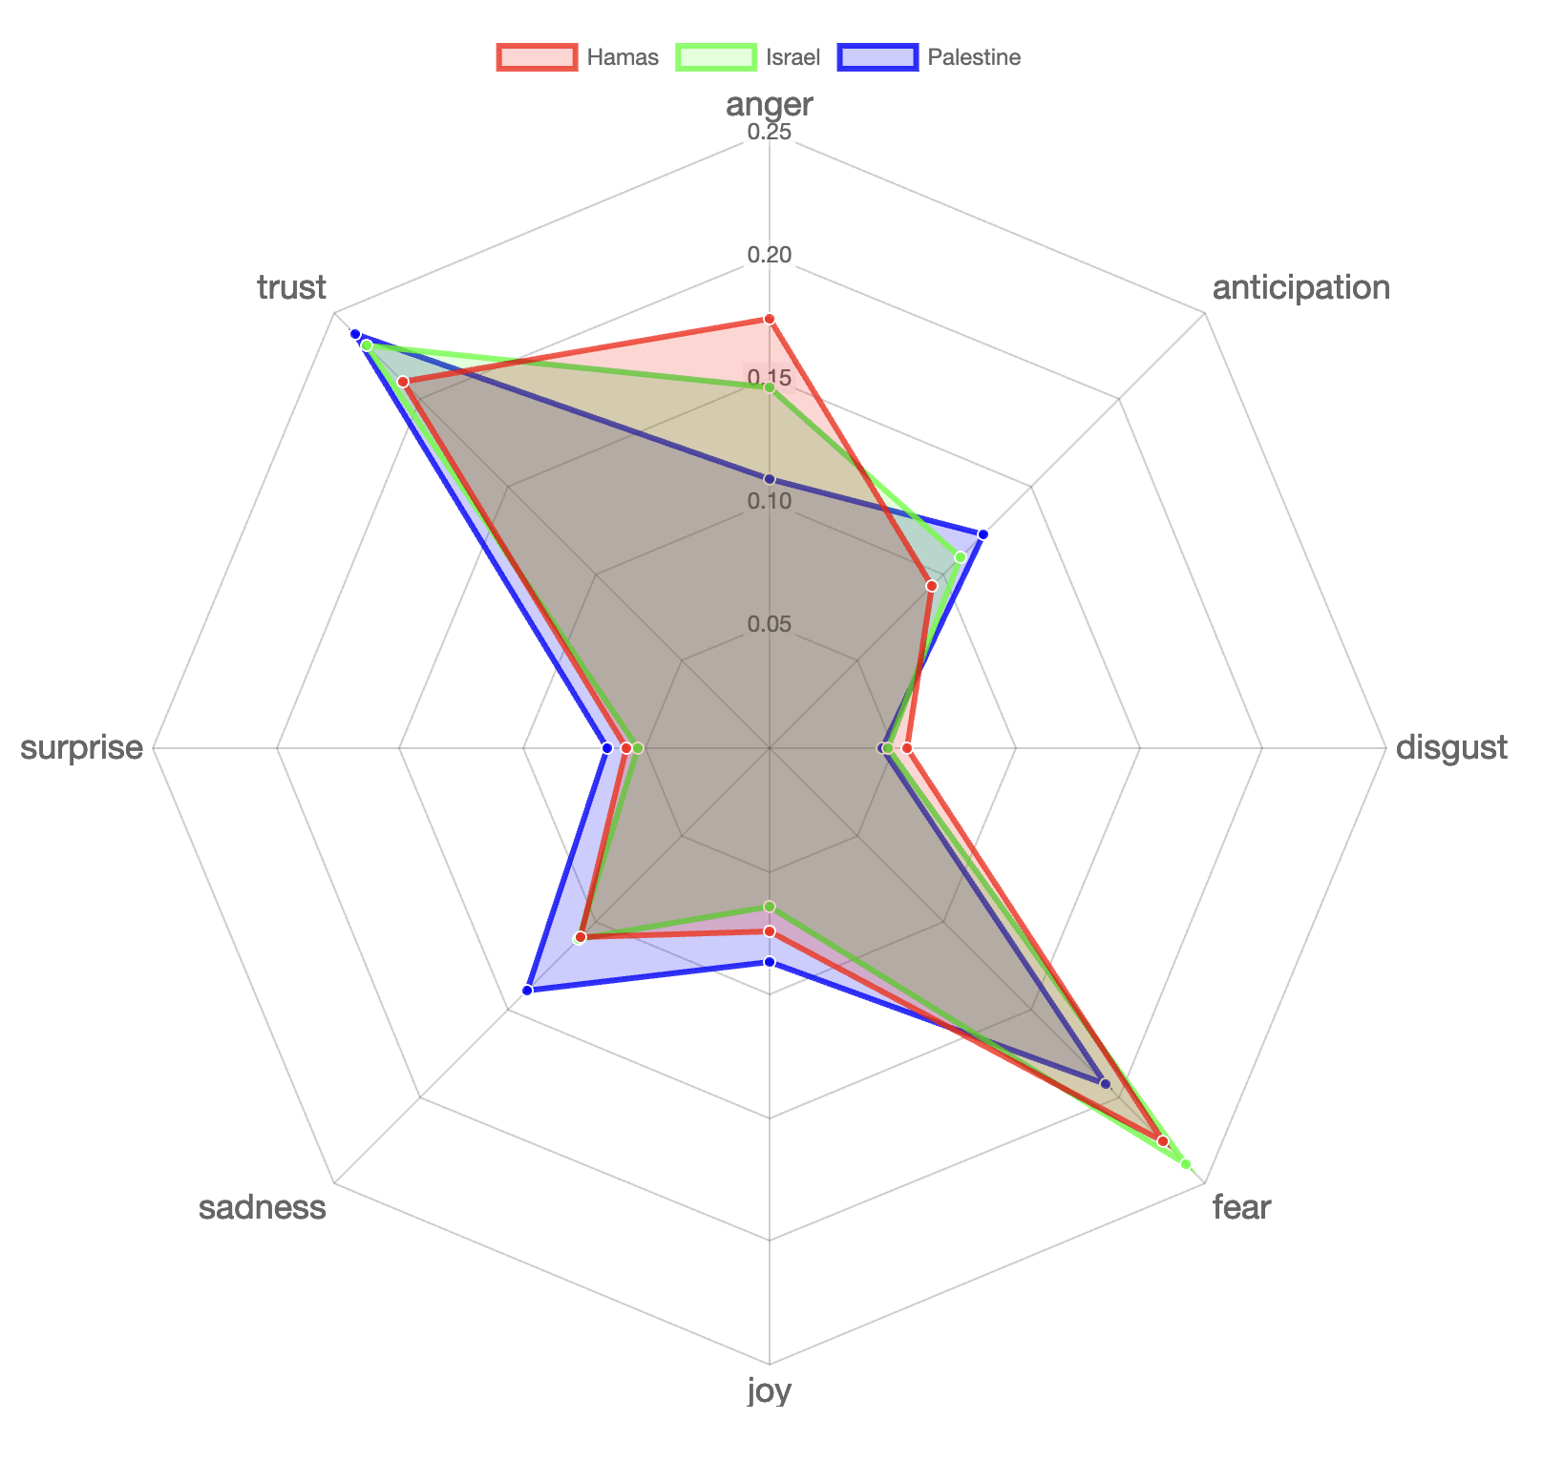
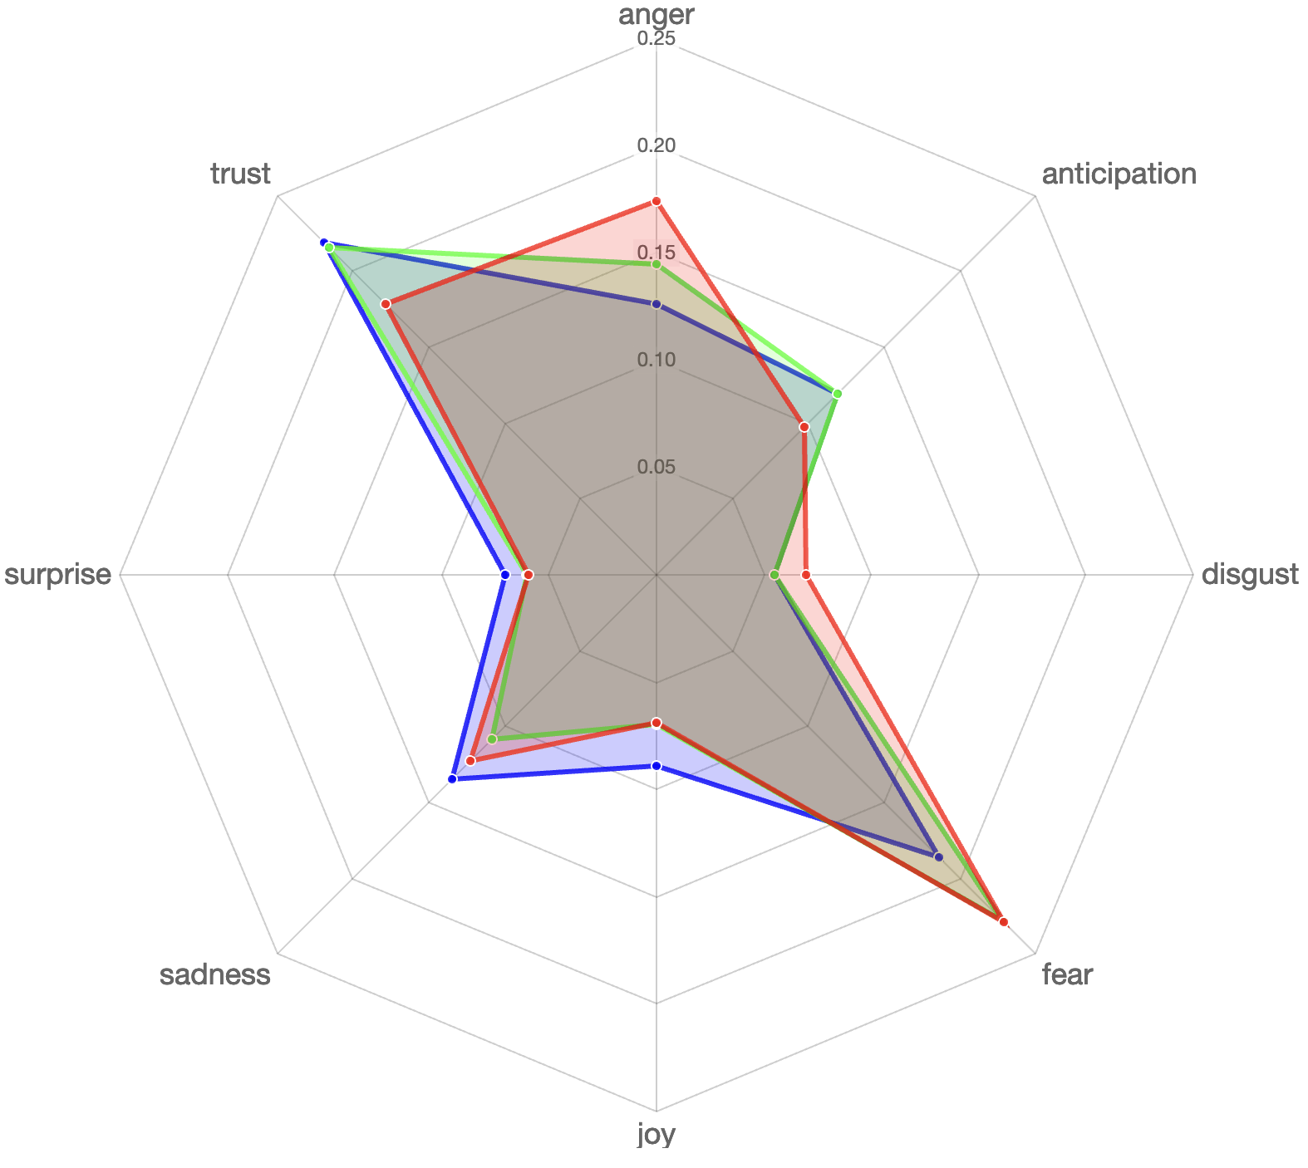
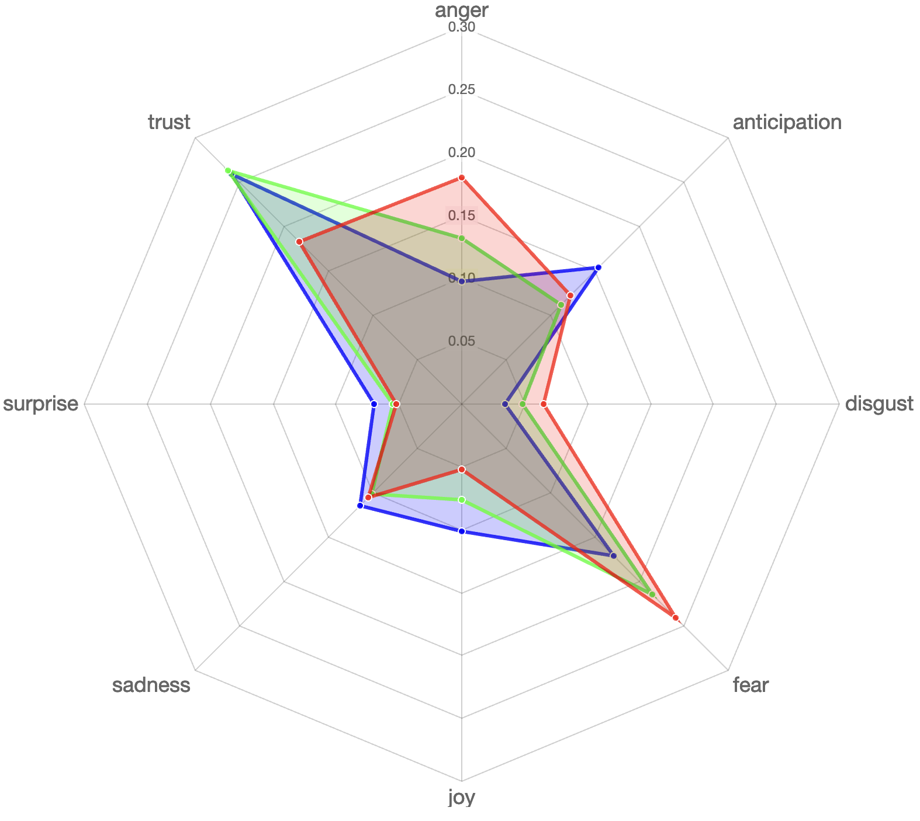
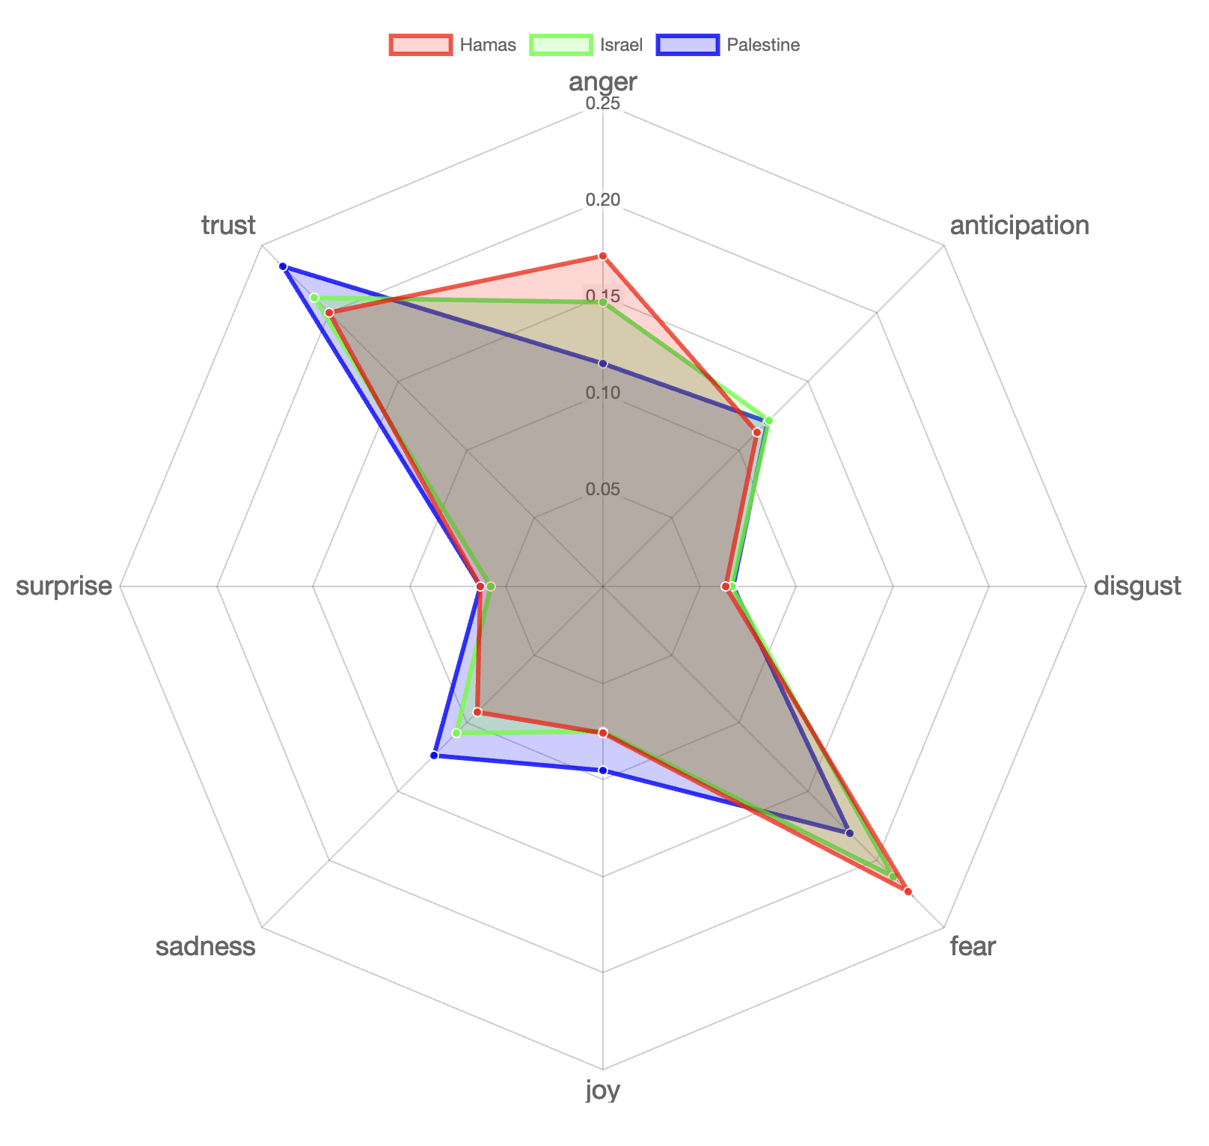
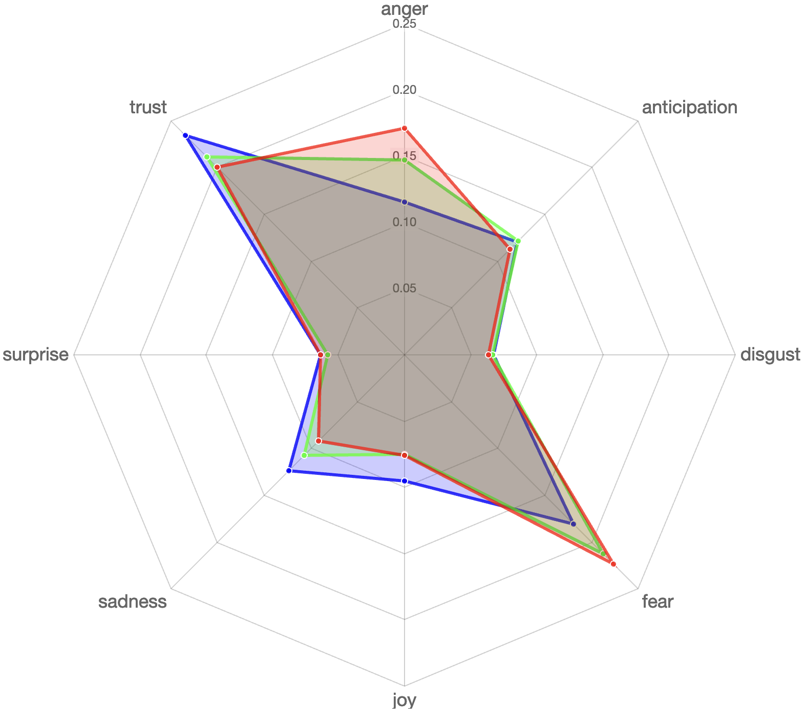
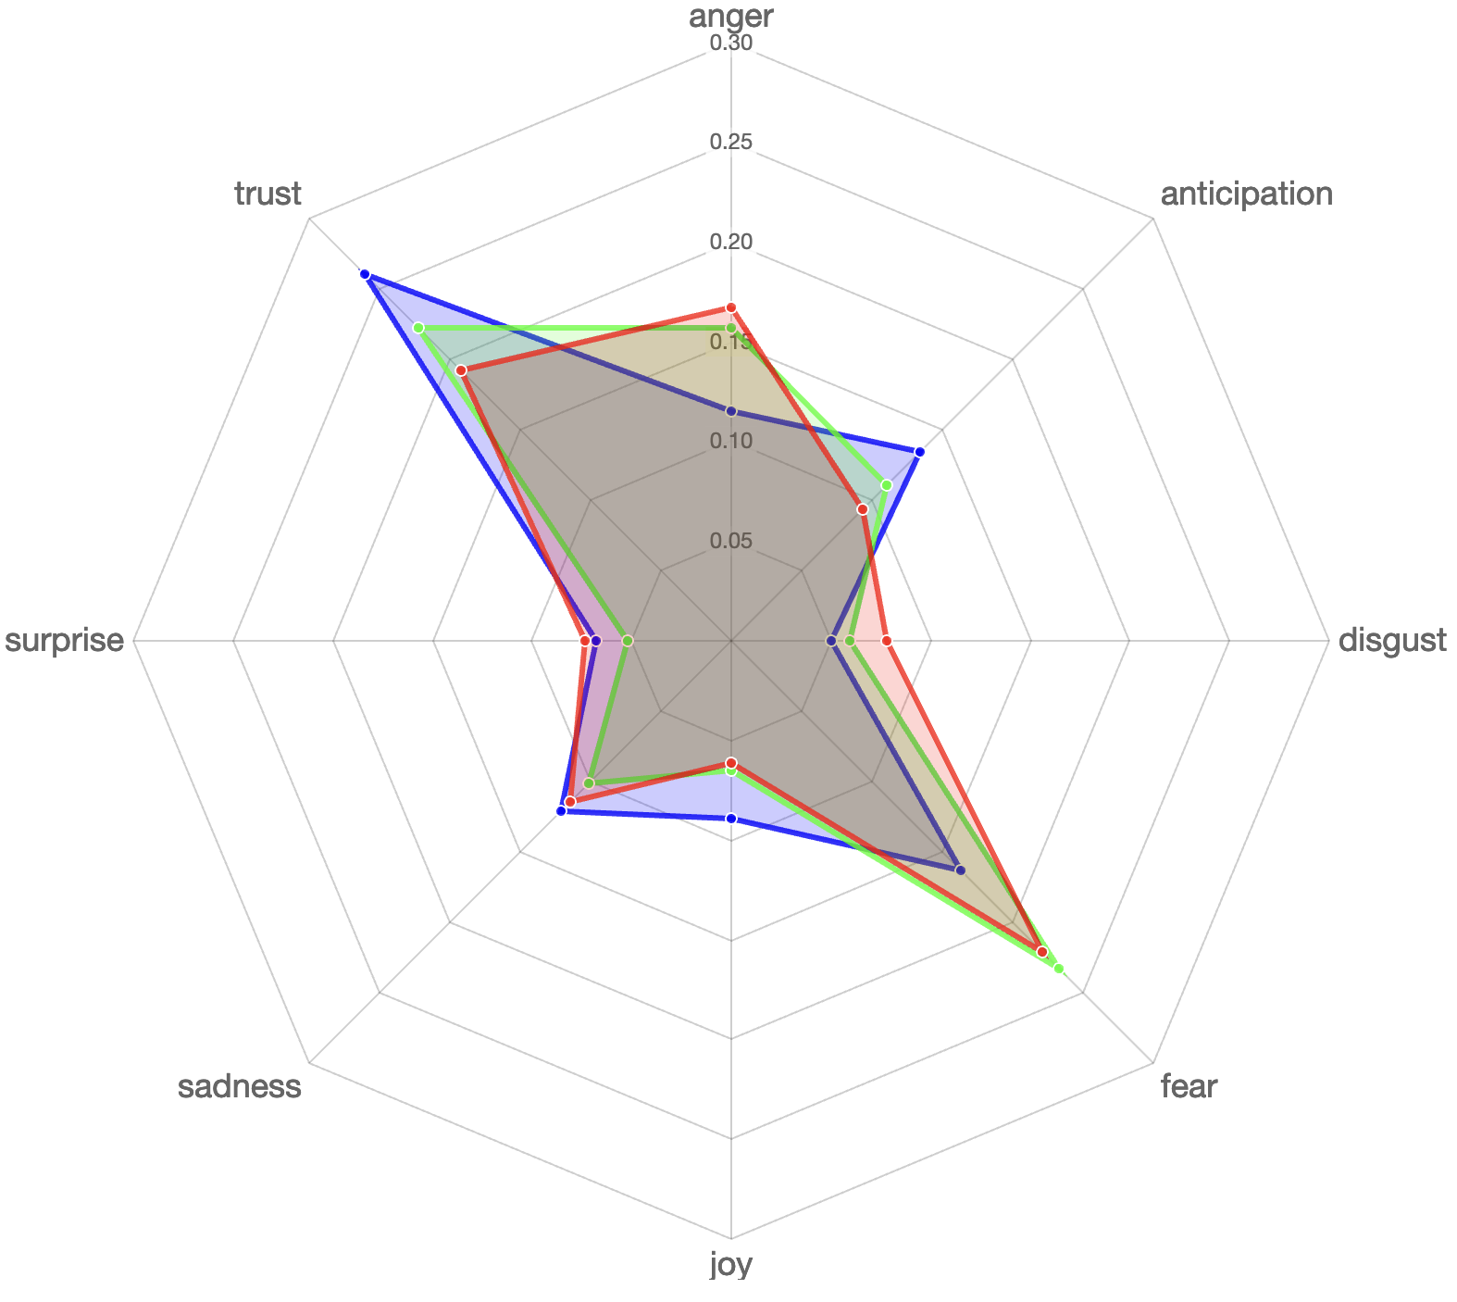
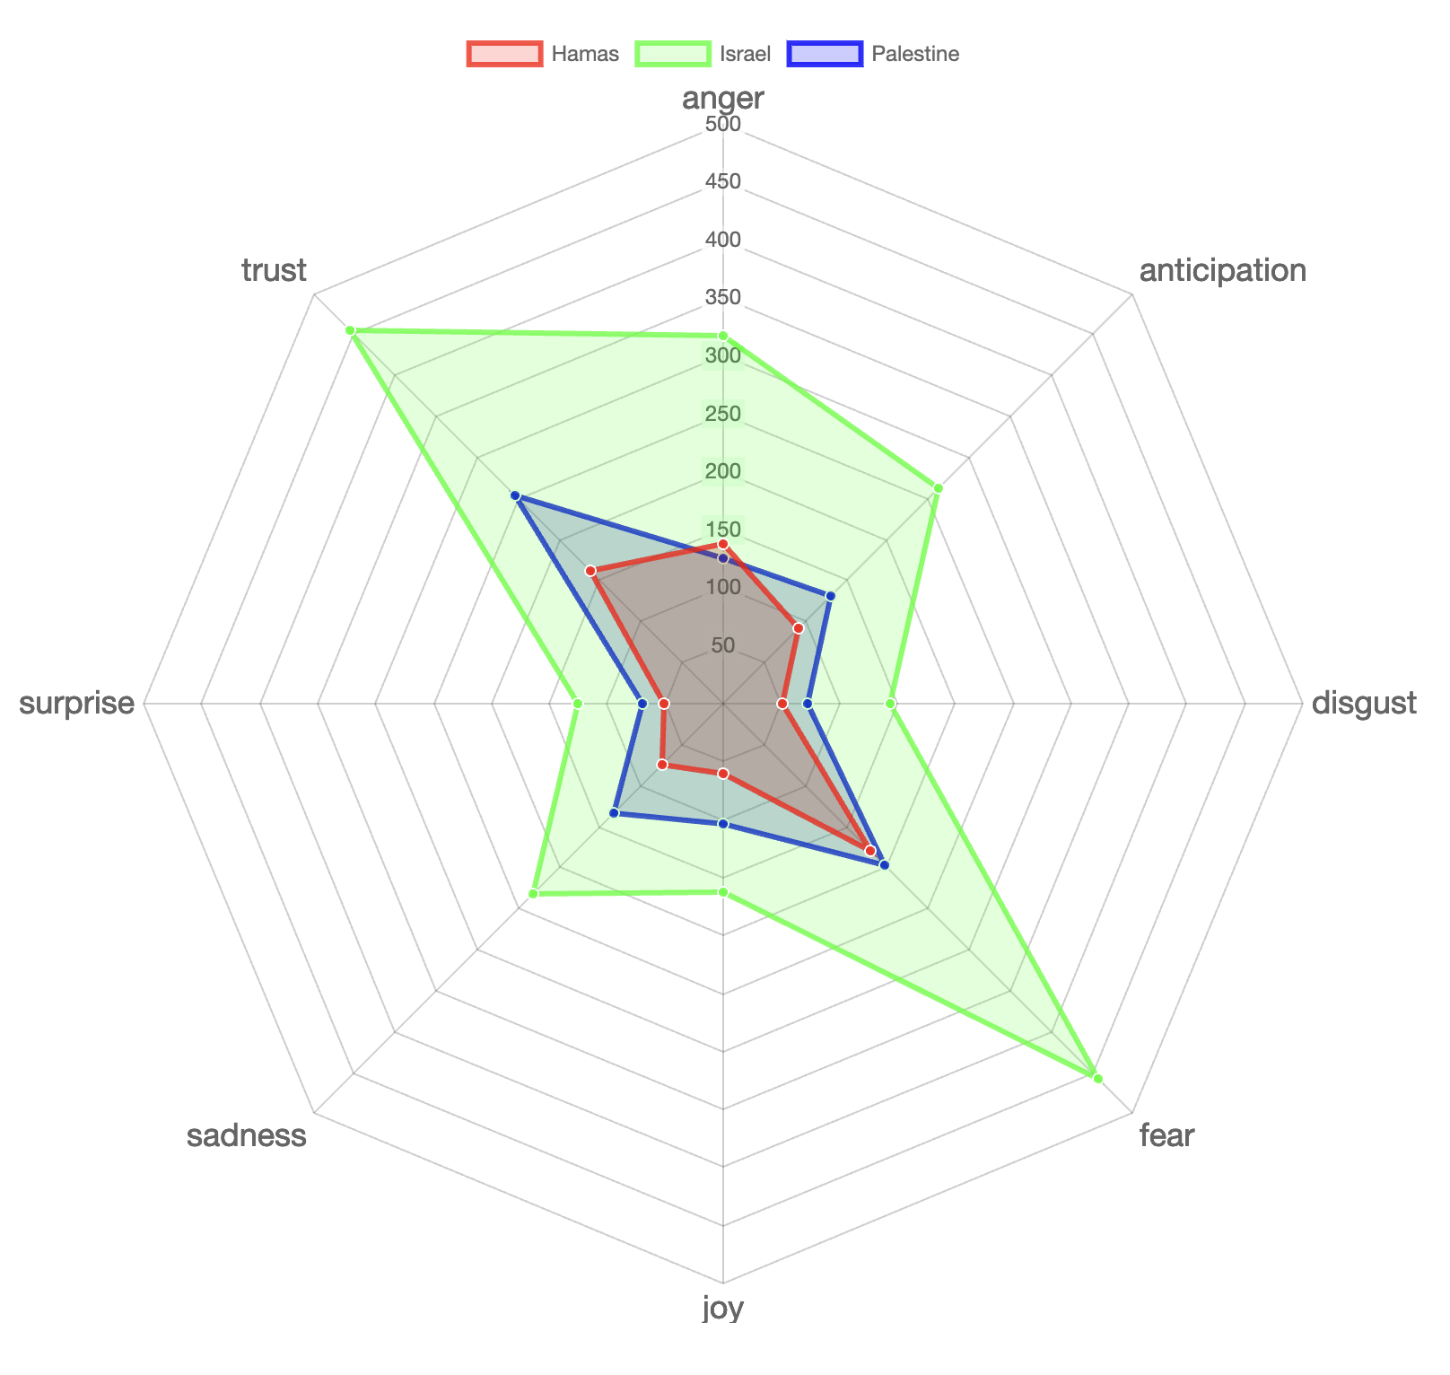
Plutchik's wheel of emotions
ExplanationR Slides
% based spread of NRC Lexicon based sentiments in Key label
Much more trust-based words for Palestine and Israel as compared to Hamas
Greater proportion of anger-based words for Hamas and Israel as compared to Palestine
Much more sadness-based words for Palestine as compared to the others
Al-Jazeera
The Guardian
South China Morning Post
Die Welt
New York Times
Times of India

Slide 26
Discussion & Limitations

Slide 27
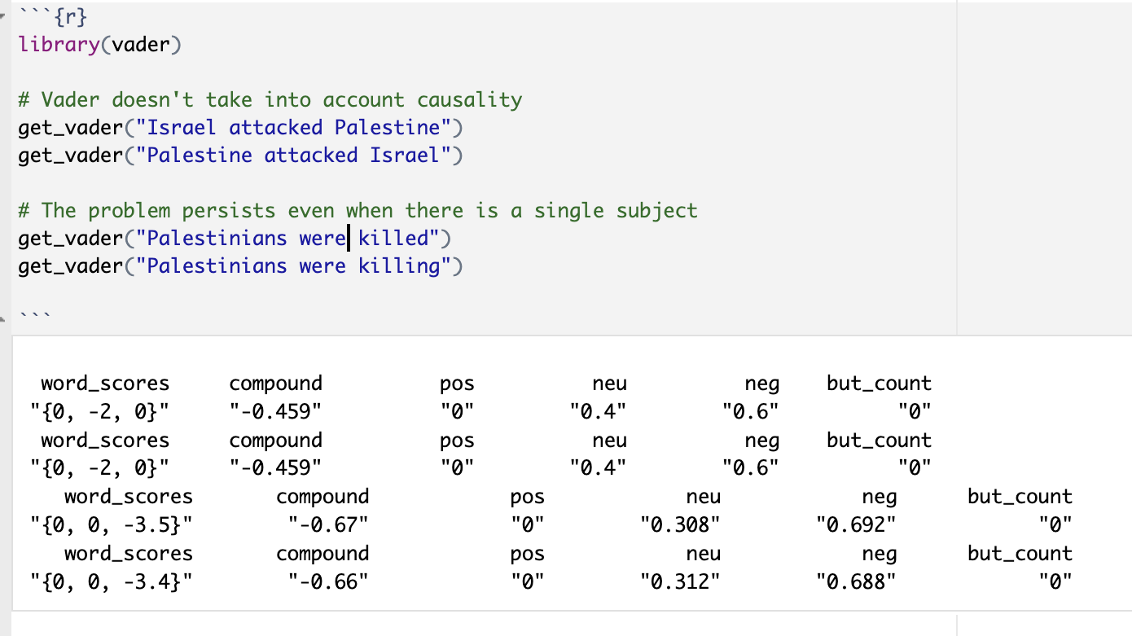
Limitations
Skewed sampling (by certain news sources and oversampling for time after outbreak of war
Models don’t account for word position or part of speech (POS): No distinction between the one attacking and the one being attacked
Small sample of news sources
Limited time period
Limited level of granularity

Slide 28
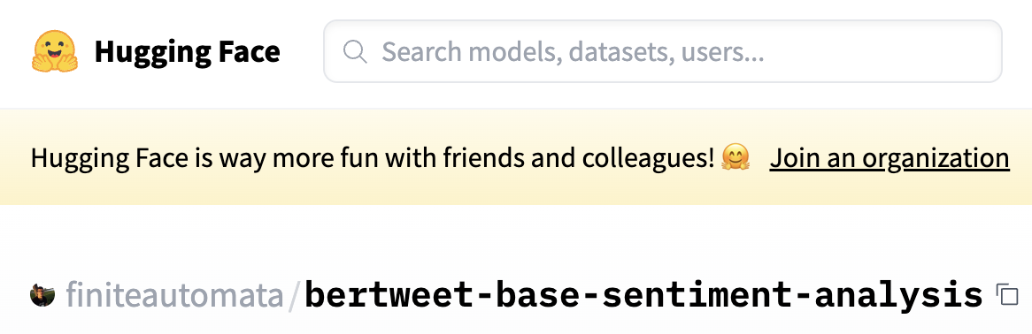
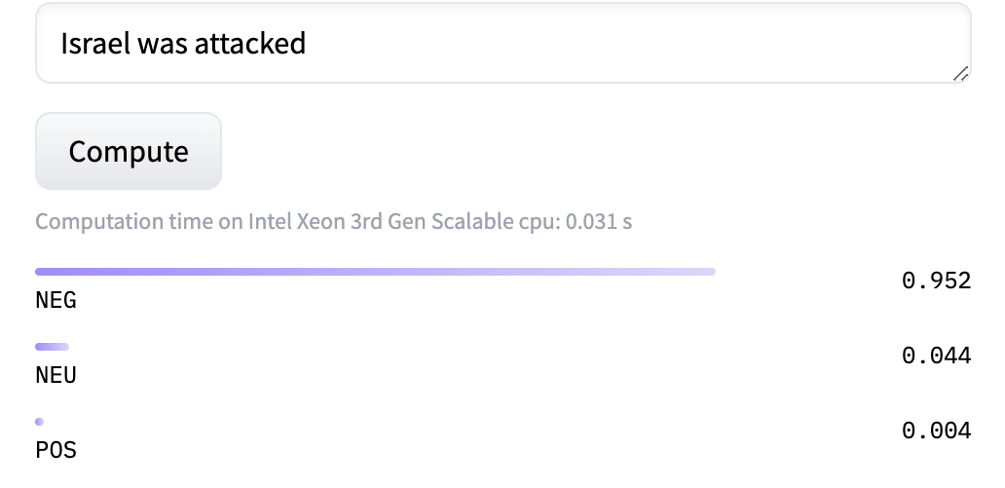
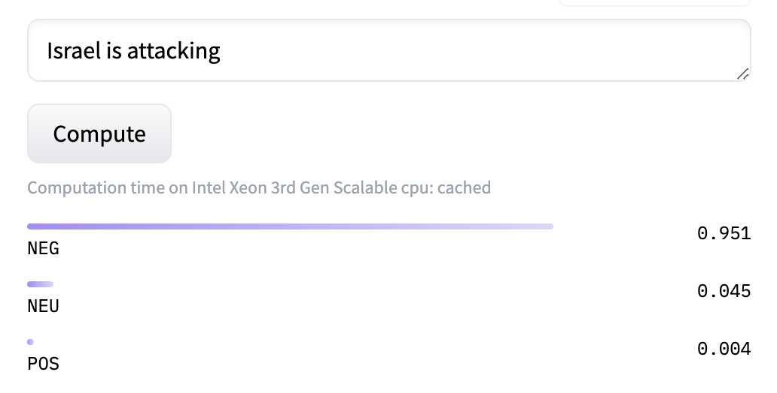
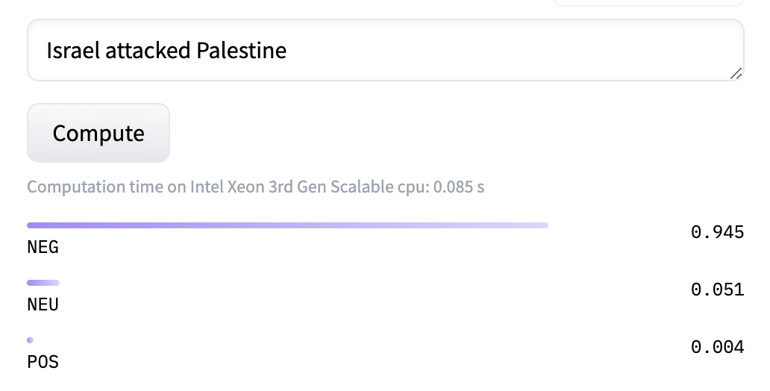
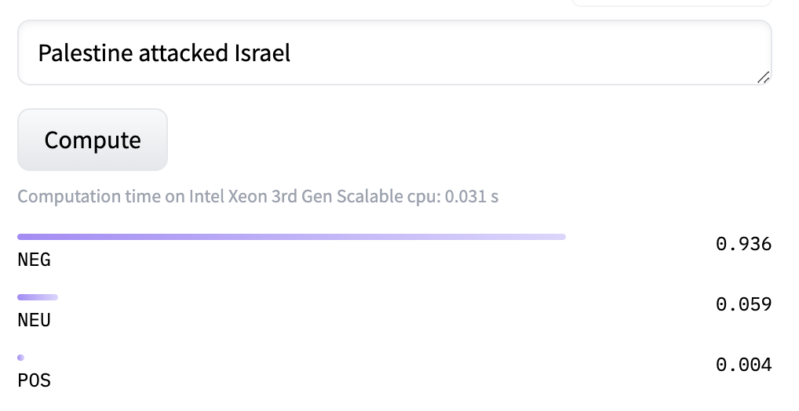
Further Work
Increase number of news sources and articles
Increase time period
Sentiment analysis by modelled topic
NLP-based method: still doesn’t classify negative sentiments into further categories (e.g. "oppressed" vs. "oppressor") and potential for marginal bias depending on training data
Fine-tuned text classification model to distinguish between the one who is acting and the one who being acted upon
Limitation in classifying negative sentiments further
Presence of Bias depending on subject

Slide 29
References:
CNN (2023). The battle for public opinion over Israel war, CNN, available at: https://edition.cnn.com/videos/world/2023/10/21/smr-israel-public-opinion-battle.cnn (Accessed: 4 Dec 2023)
İnceoğlu, Y. (2023). ‘Dead’ versus ‘Killed’: A closer look at the media bias in reporting Israel-Palestine Conflict, The Wire India, available at: https://thewire.in/media/dead-versus-killed-a-closer-look-at-the-media-bias-in-reporting-israel-palestine-conflict (Accessed 4 Dec 2023)
Kressler, N. (1987). Biased Judgements of Media Bias: A Case Study of the Arab-Israeli Dispute, Political Psychology, 8(2), pp.211-227, available at: https://doi.org/10.2307/3791301 (Accessed: 4 Dec 2023)
Leonhardt, D. (2023). What the Polls Say About Gaza, The New York Times, available at: https://www.nytimes.com/2023/11/30/briefing/polling-gaza.html (Accessed: 4 Dec 2023)
Tilett, A. (2023). Israel is winning the war against Hamas but losing public opinion, Financial Review, available at: https://www.afr.com/world/middle-east/israel-is-winning-the-battle-against-hamas-but-losing-the-pr-war-20231101-p5egoi (Accessed: 4 Dec 2023)
Ullah, A. (2021) Will UK's proscription of Hamas stop charity work in Gaza?, Middle East Eye, available at: https://www.middleeasteye.net/news/palestine-uk-hamas-aid-gaza-affected (Accessed: 4 Dec 2023)

Slide 30
Backup

Slide 31
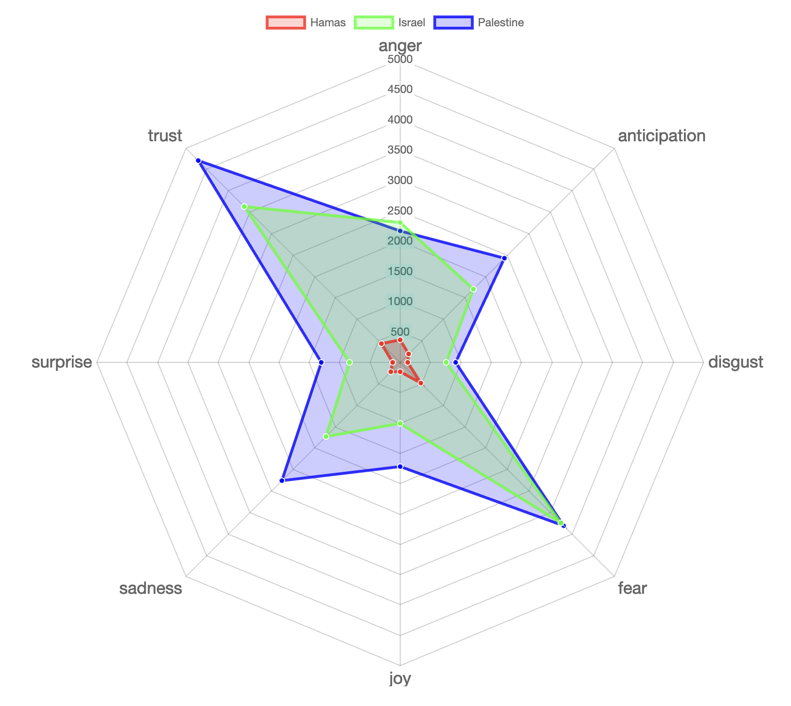
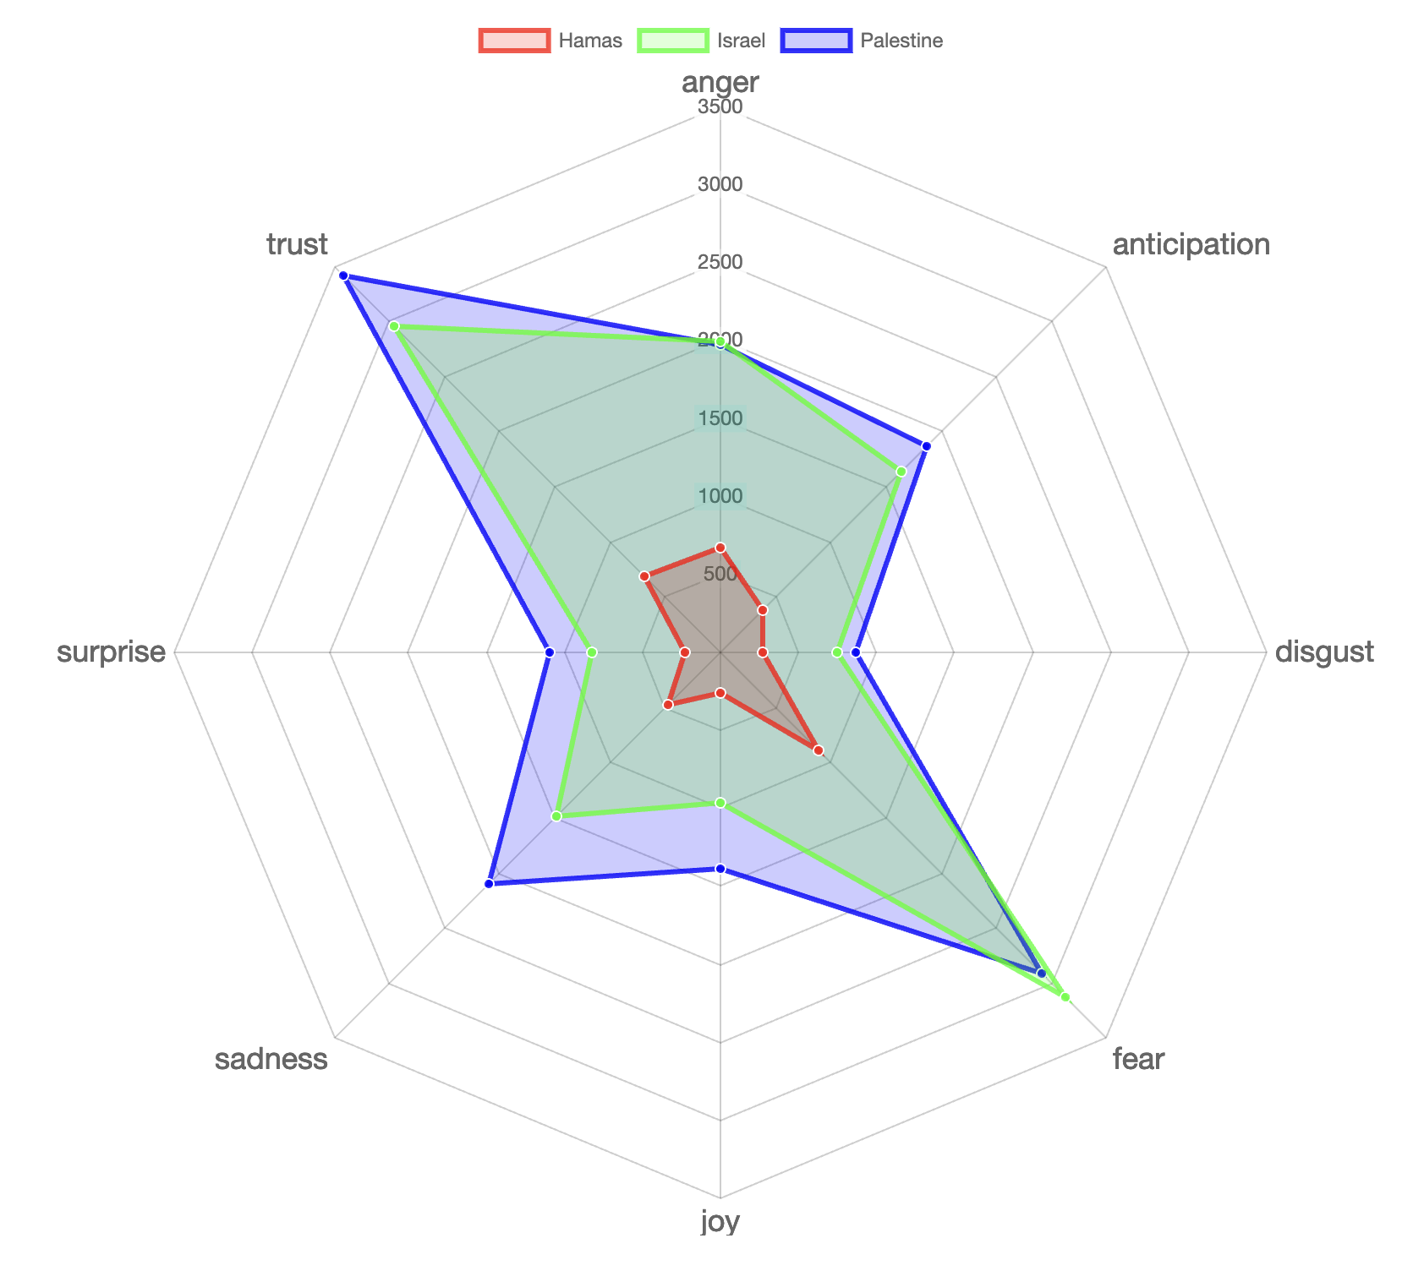
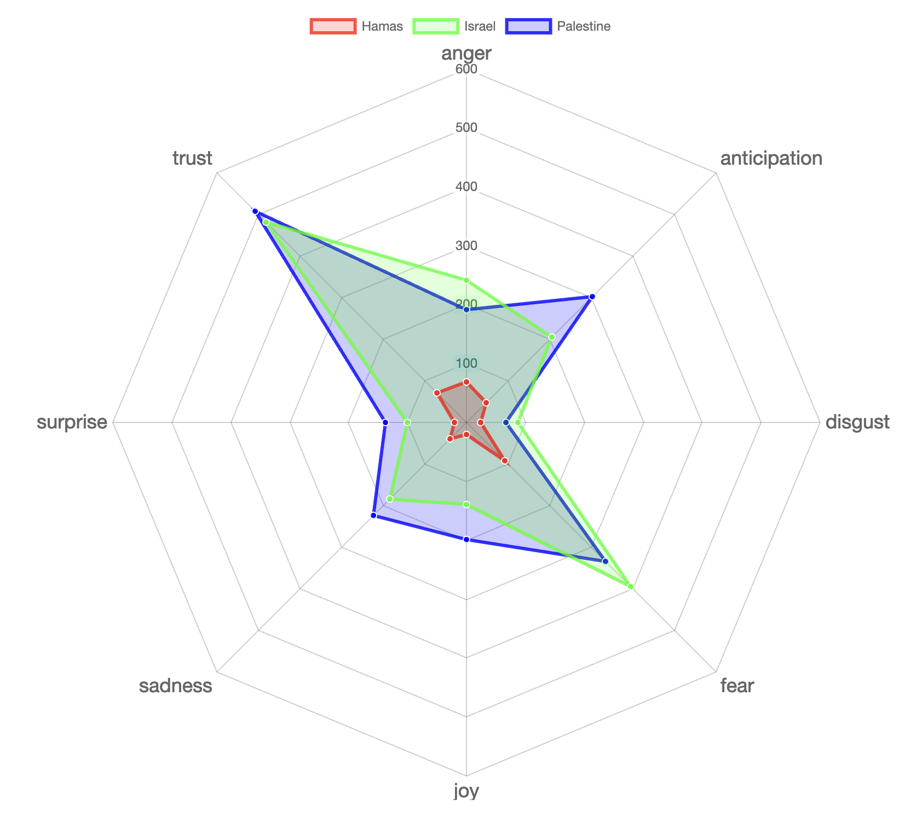
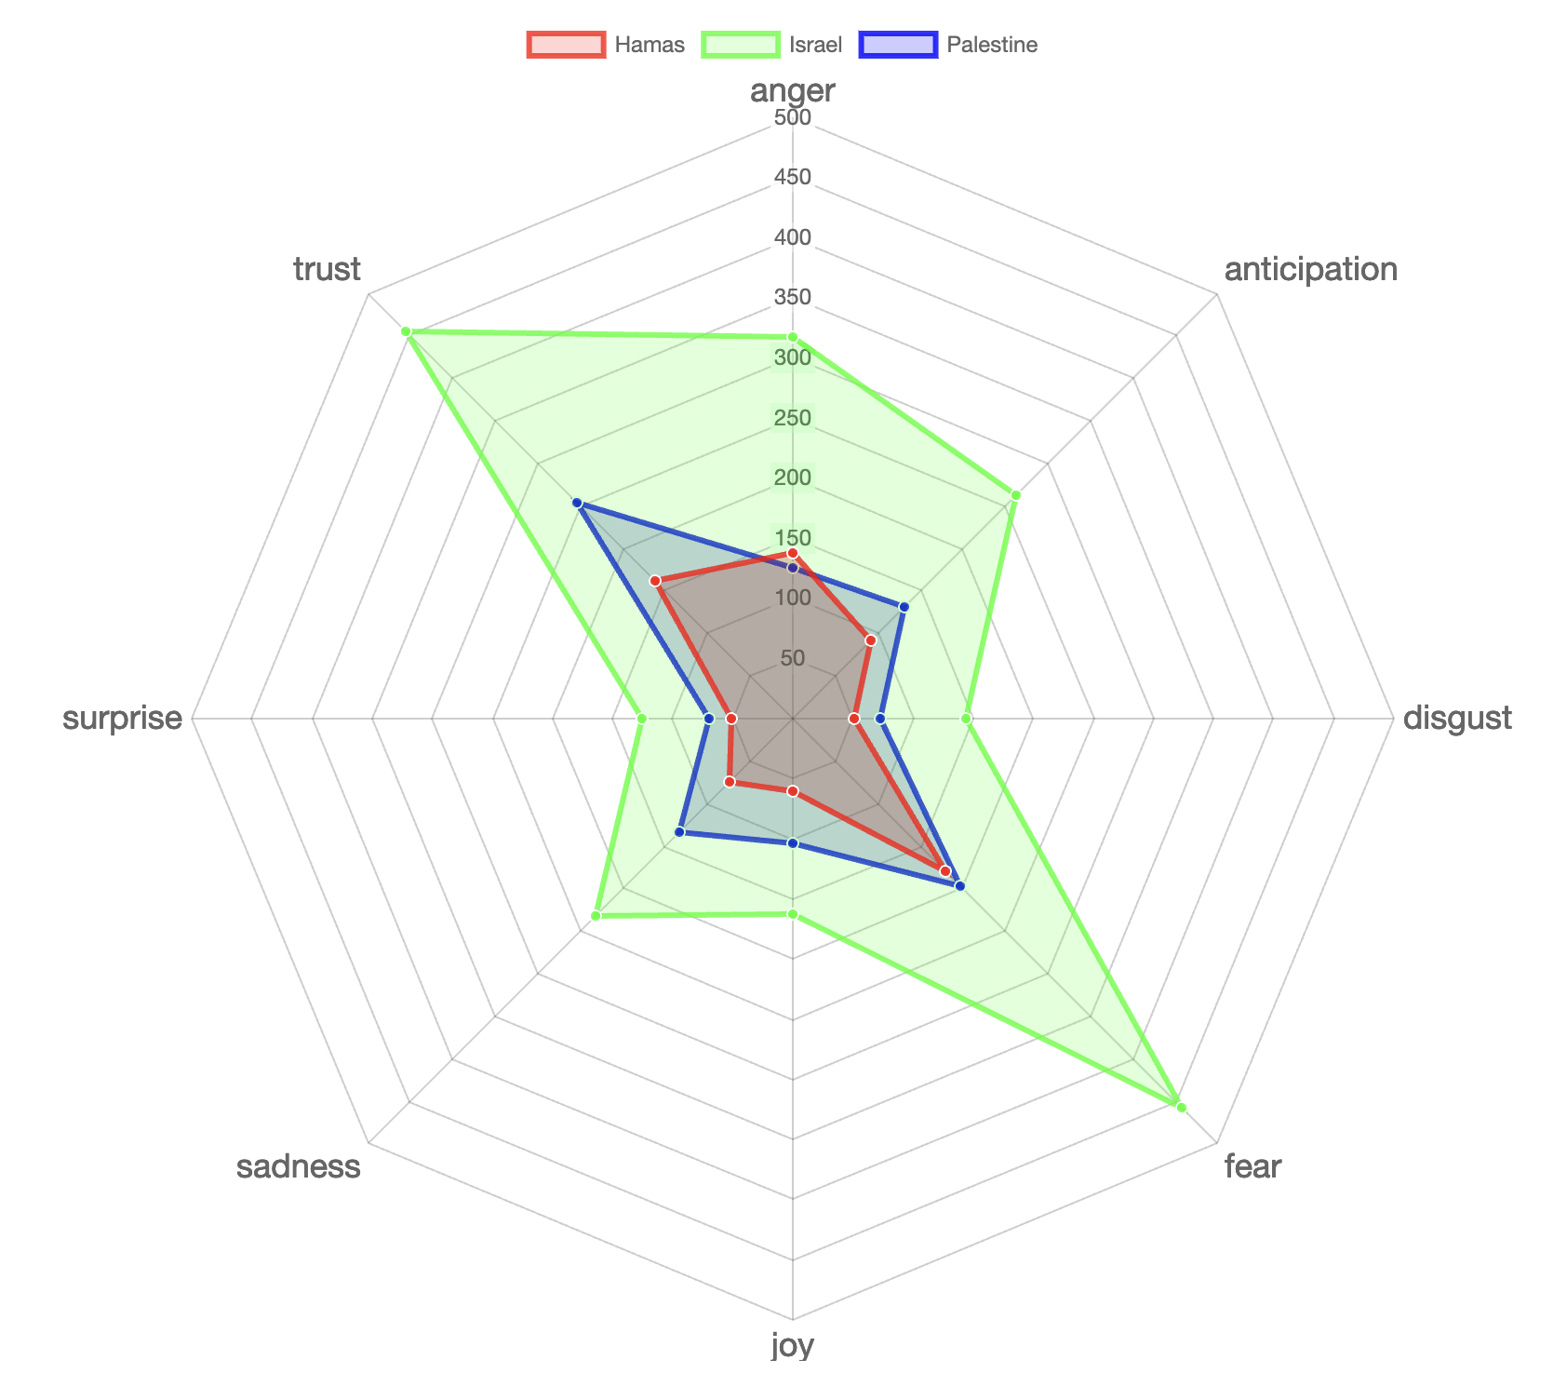
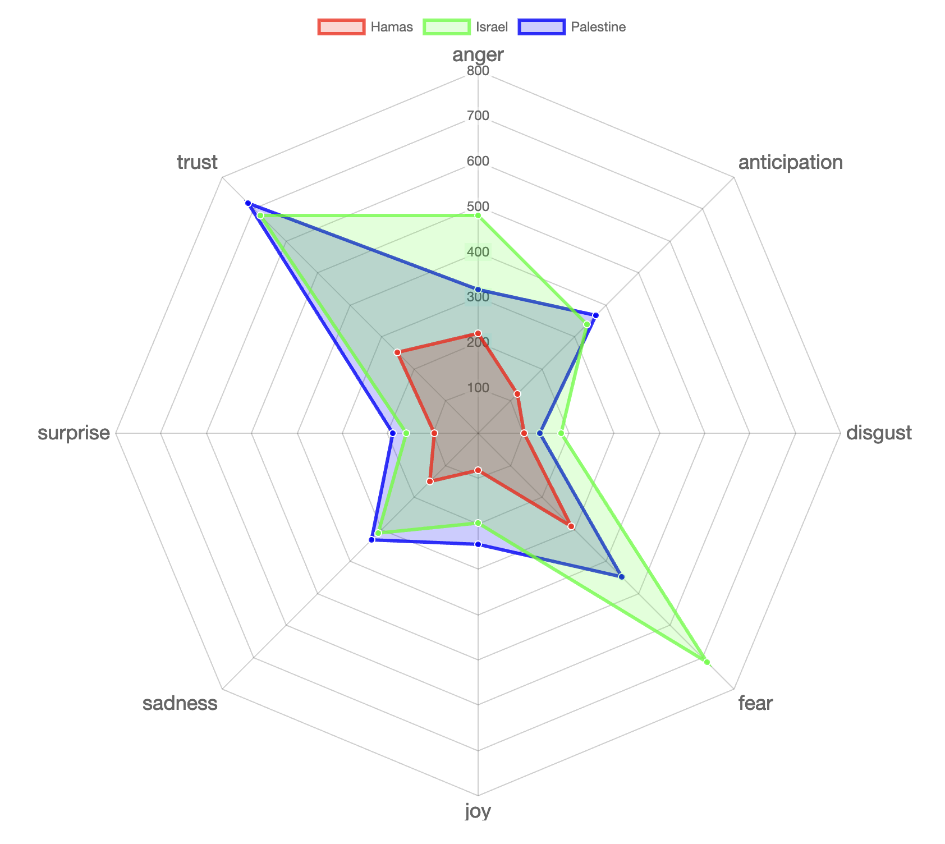
Plutchik's wheel of emotions
ExplanationR Slides
Absolute count of NRC Lexicon based sentiments in Key label
Originally proposed in 1980 by Robert Plutchik as a psychoevolutionary classification approach for general emotional responses
The bigger the spread of a label, the more associated NRC emotions were reflected in the respective texts.
Die Welt used a lot more NRC emotion words for Israel compared to Palestine; Al-Jazeera and The Guardian used much more for Palestine as compared to Israel based on the key classification.
Since these are absolute counts, they are dependant upon the number of words for the respective label and newspaper in our corpus.
Al-Jazeera
The Guardian
South China Morning Post
Die Welt
New York Times
Times of India

Slide 32
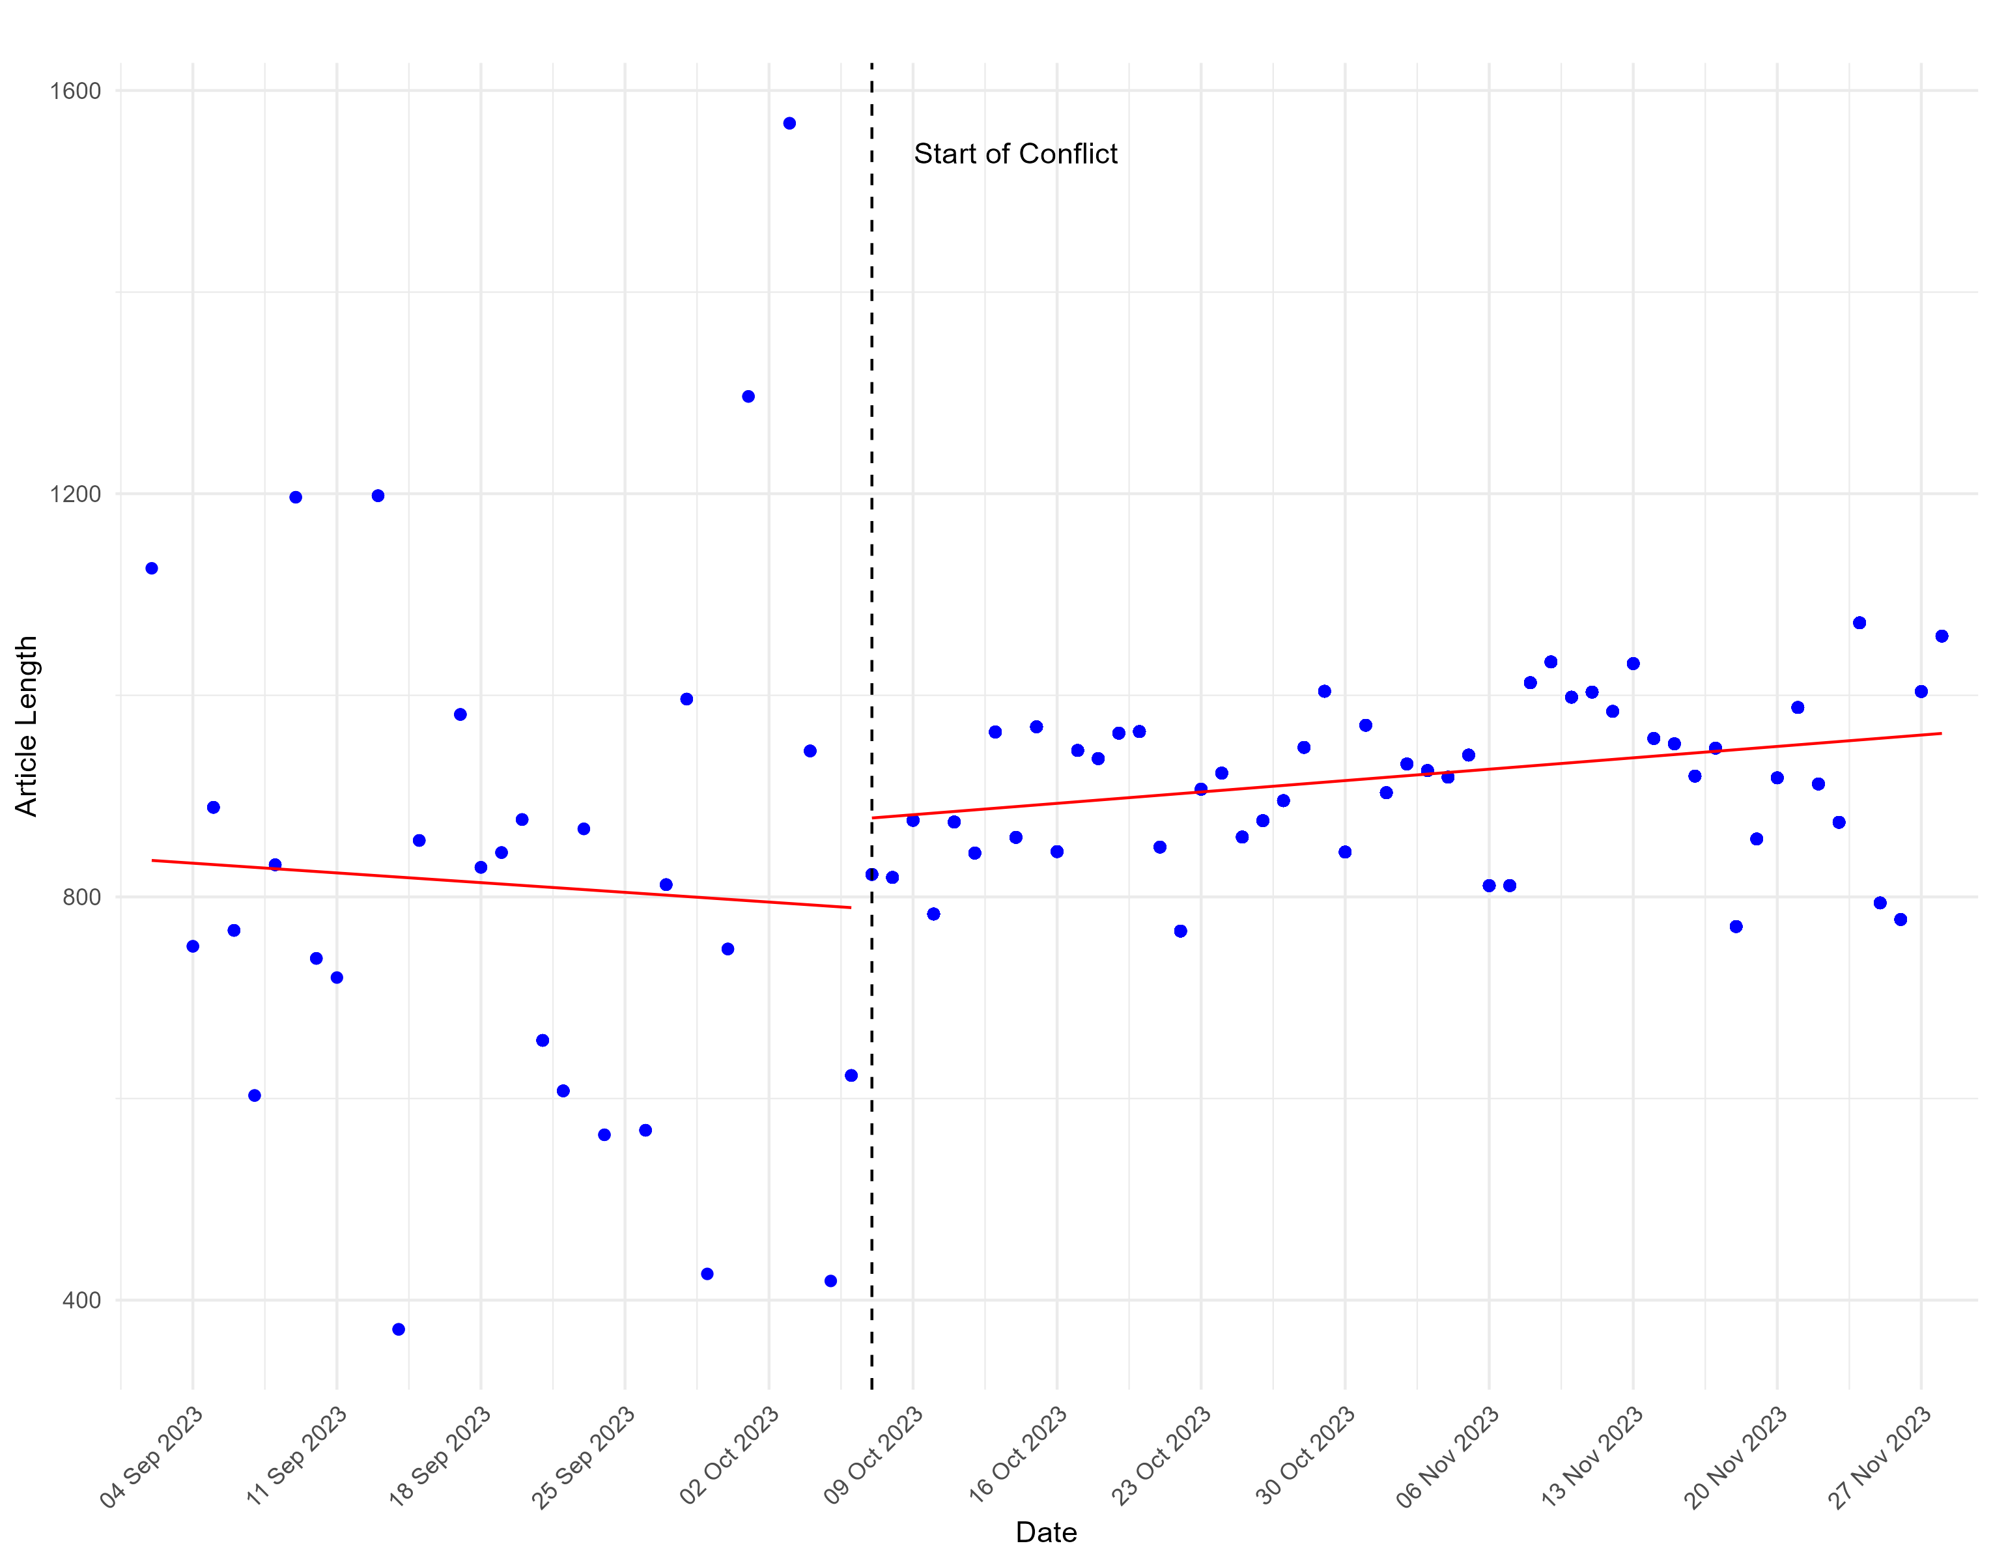
Article length over time and TFIDF
Newspaper Articles Length over time
Most frequent words (over entire corpus)

Slide 33
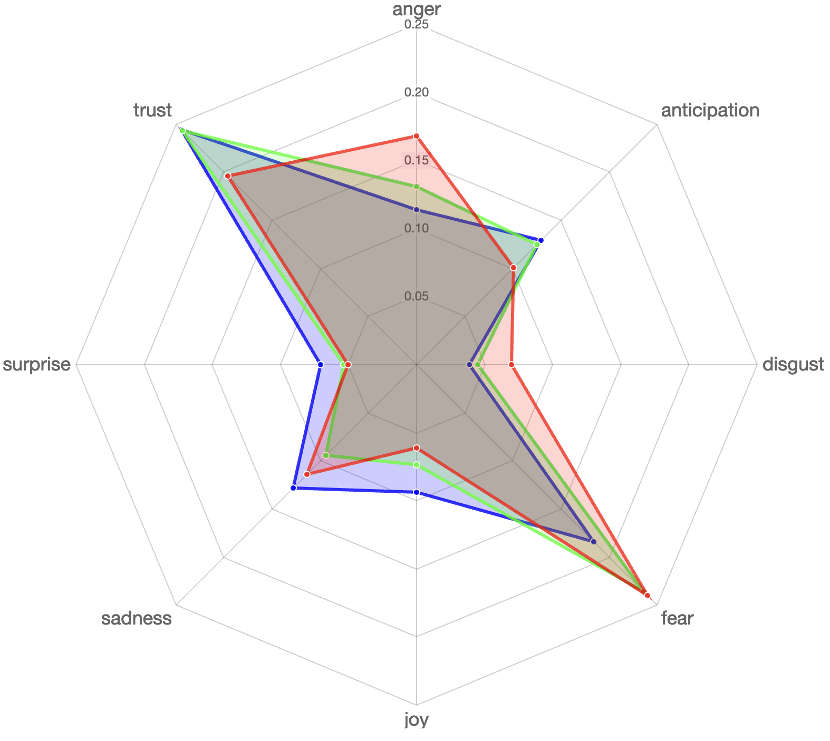
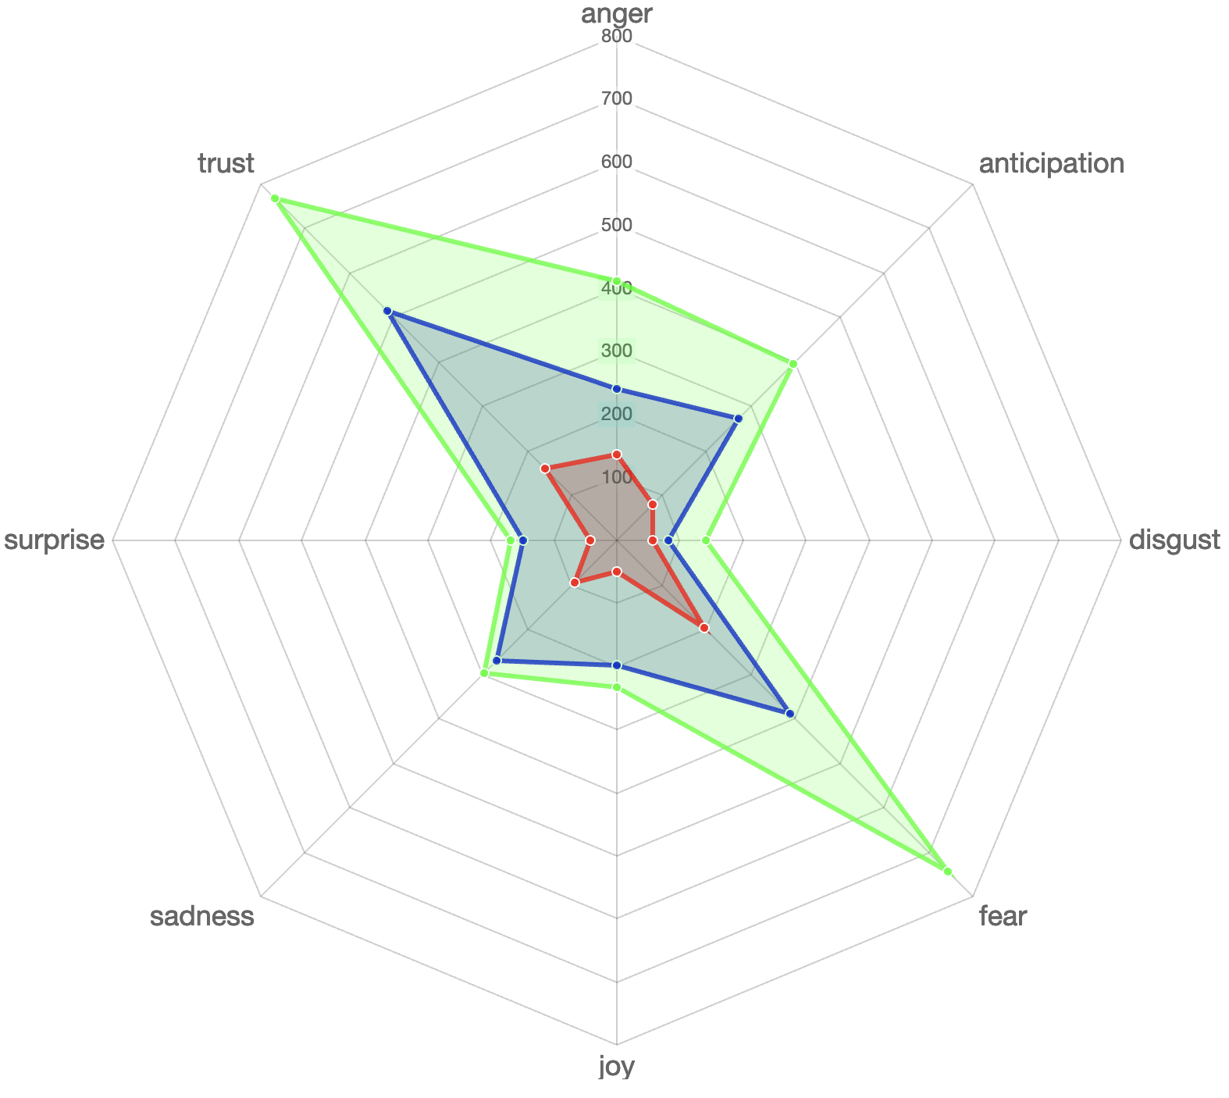
The Straits Time Singapore

